Slide 1

Introduction to HW Security & Trust
Dr. Farimah Farahmandi
Fall 2023
University of Florida

Slide 2
Acknowledgement
Reference Book
M. Tehranipoor and C. Wang, Introduction to Hardware Security and Trust, Springer, 2011
Thanks to many colleagues, students, collaborators, etc. for their help and support over the past many years in putting the content of the book and the slides together.
Notes:
2

Slide 3
EEE4714 / EEE5716
Title: “Introduction to Hardware Security and Trust”
Instructor
Farimah Farahmandi, Yangbin Wang Rising Star Endowed Professor, ECE Department
Meeting time
1:55 – 2:45pm Tuesday
1:55 – 3:50pm Thursday
Meeting place
NEB 202 (Online for EDGE)
Prerequisites
EEE3701C: Digital Logic (or equivalent)
Self-contained
A brief overview of VLSI design and test will be given

Slide 4
STAs for the Class
Md Sami Ul Islam
PhD Student, Dept of ECE
Email: md.sami@ufl.edu
Office Hour: Thur 4-5pm
Md Rafid Muttaki
PhD Student, Dept of ECE
Email: m.muttaki@ufl.edu
Office Hour: Tue 11 am-12 pm
Sajeed Mohammad
PhD Student, Dept of ECE
Email: mlnu@ufl.edu
Office Hour: Wed 3-4pm
Office Hours for the Instructor:
Tuesdays 3-4pm, Online

Slide 5
Overview of Course Content
Cryptographic hardware:
Vulnerabilities, processing overhead
Attacks:
Physical, invasive, non-invasive/side-channel
Physically unclonable functions (PUFs)
True random number generation (TRNG)
Anti-piracy:
Watermarking, passive and active hardware metering
FPGA security
Trusted design in FPGAs
Hardware Trojan detection and prevention
Counterfeit detection and avoidance

Slide 6
Goals
Learning the state-of-the-art security primitives and methods as well as emerging technologies and security trends
Integration of security as a design metric, not as an afterthought for the system
Protection of the design intellectual property against piracy and tampering
Better understanding of attacks and providing countermeasures against them
Better understanding of vulnerabilities in design and fabrication processes
Better understanding of the electronic component supply chain vulnerabilities

Slide 7
More to Read …
Reading
Papers from the contemporary literature
Further possible reading
Mihir Bellare and Phil Rogaway, Introduction to Modern Cryptography
Ross J. Anderson. Security Engineering: A guide to building dependable distributed systems. John Wiley and Sons, 2001
Matt Bishop, Computer Security: Art and Science, Addison-Wesley, 2003
William Stallings. Cryptography and Network Security, Fourth edition, 2007
M. Tehranipoor and F. Koushanfar, "A Survey of Hardware Trojan Taxonomy and Detection," IEEE Design and Test of Computers, 2010.
M. Tehranipoor, H. Salmani, and X. Zhang, Integrated Circuit Authentication: Hardware Trojans and Counterfeit Detection, Springer July 2013.
U. Guin, D. DiMase, and M. Tehranipoor, “Counterfeit Integrated Circuits: Detection, Avoidance, and the Challenges Ahead,” Journal of Electronic Testing: Theory and Applications (JETTA), Feb. 2014.

Slide 8
More to Watch!
Videos
What's inside a microchip? http://www.youtube.com/watch?v=GdqbLmdKgw4
Zoom Into a Microchip http://www.youtube.com/watch?v=Fxv3JoS1uY8
Public Key Cryptography: RSA Encryption: http://www.youtube.com/watch?v=wXB-V_Keiu8
Counterfeit Electronics Could Be Dangerous, Funding Nefarious People http://www.youtube.com/watch?v=dbZiUe6guxc
How Computers and Electronics Are Recycled http://www.youtube.com/watch?v=Iw4g6H7alvo
Counterfeit Electronic Components Process http://www.youtube.com/watch?v=5vN_7NJ4qYA
Counterfeit Inspection http://www.youtube.com/watch?v=MbQUvu2LN6o
Gold from waste circuit electronics https://www.youtube.com/watch?v=4yGPm1U7U6s
Introduction to Hardware Hacking and Reverse Engineering https://www.youtube.com/watch?v=Q08jA2vVXfQ

Slide 9
Grading and Project
Grading (Five components)
One Midterm Exam: 20%
One Final Exam: 20%
Project Demo/Report: 20%
Student Presentation: 15%
2-3 HW Assignments (one before Midterm and another after Midtrerm): 15%
2-3 Pop Quizzes, 10%
This is subject to change
Project
Groups of 3-4 for on-site students and individual for EDGE students
Either propose or select from my list of potential projects/datasets
Some projects involve hardware component (Xilinx FPGA development board)

Slide 10
Software Tools Needed for Projects and HWs
PC or Mac or Linux Platforms are OK.
Statistical analysis of the attacks
R statistical computing package (more info later)
Verilog/VHDL Tools:
Synopsys / Xilinx design flow
Projects Involving FPGA Development Board
Xilinx Vivado Synthesis tools (student edition would suffice)

Slide 11
Course Outline
Introduction to Hardware Security & Trust
Introduction to Cryptography
Basics of VLSI Design and Test
Security Based on Physically Unclonability and Disorder
Hardware Metering
Watermarking of HW IPs
Physical Attacks and Tamper resistance
Side Channel Attacks and Countermeasures, Countermeasures for Embedded Microcontrollers
Fault Injection Attacks
Trusted Design in FPGAs
Security in Embedded Systems
Security for RFID Tags
Hardware Trojans: IC Trust (Taxonomy and Detection)
Hardware Trojans: IP Trust (Detection)
Design for Hardware Trust
Protecting against Scan-based Side Channel Attacks
Secure JTAG
Counterfeit Detection and Avoidance

Slide 12
NSF SFS Opportunity (New)
The National Science Foundation (NSF) has awarded the University of Florida funding for 17 CyberScholars for the period 2017-2022.
Highly prestigious CyberCorps®: Scholarship For Service (SFS)
The SFS program is offered by the NSF and co-sponsored by the Department of Homeland Security (DHS).
Scholarship recipients shall pursue academic programs in: Cybersecurity with emphasis on hardware and systems security (HSS)
Domestic students are eligible to apply
The program will fund the final:
Two years of a master's-level program
Two-Three years of study for the bachelor's degree
Three years of research-based doctoral-level study

Slide 13
NSF SFS Opportunity (New)
Program Benefits
Stipend: $22,500 per year for undergraduate students; $34,000 per year for master's degree students and $34,000 per year for doctoral students.
Full tuition and education related fees.
Health insurance reimbursement (up to $3000 per year).
Professional development allowance (travel, professional certification etc. (up to $4000 per year) and a book allowance (up to $2,000 per year).
Government summer internships and job opportunities with the world’s leading security organization.
Focused on Cybersecurity Education, the Scholarship For Service program gives students scholarship funds in exchange for service in the federal government for a period equivalent to the length of their scholarship (up to three years).
Visit https://www.sfs.opm.gov/ for more information

Slide 14
Hardware Security
Cybersecurity experts have traditionally assumed that the hardware underlying information systems is secure and trusted.
However, such assumption is no longer true.

Slide 15
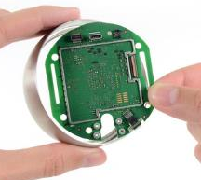
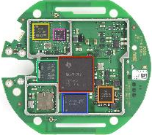
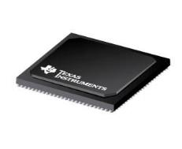
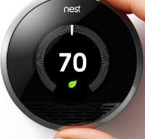
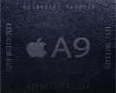
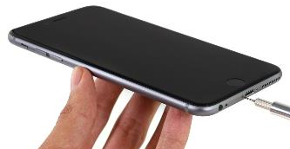
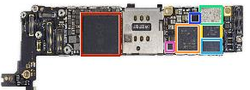
What is Hardware?
µP
SOC
Electronic System
System Hardware – acts as the “root-of-trust”: PCB → IC (SoC | µP)

Slide 16
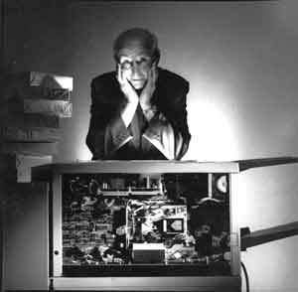
Example Attack
Roy Zoppoth stands over a Xerox 914 copy machine, the world's first, which was used in soviet embassies all over the world. The machine was so complex that the CIA used a tiny camera designed by Zoppoth to capture documents copied on the machine by the soviets and retrieved them using a "Xerox repairman" right under the eyes of soviet security.
Photo from edit international courtesy of Roy Zoppoth

Slide 17
Motivation – HW Security
HW security is becoming increasingly important
Hardware security sneaks into PCs, Robert Lemos, CNET News.com, 3/16/05
Microsoft reveals hardware security plans, concerns remain, Robert Lemos, SecurityFocus 04/26/05
Princeton Professor Finds No Hardware Security In E-Voting Machine, Antone Gonsalves, InformationWeek 02/16/07
Secure Chips for Gadgets Set to Soar, John P. Mello Jr. TechNewsWorld, 05/16/07
Army requires security hardware for all PCs, Cheryl Gerber, FCW.com, 7/31/2006
Visit Facebook group on Hardware Security

Slide 18
Example Attack
Pentagon’s ‘Kill Switch': Urban Myth?
The Pentagon is worried that "backdoors" in computer processors might leave the American military vulnerable to an instant electronic shut-down. Those fears only grew, after an Israeli strike on an alleged nuclear facility in Syria. Many speculated that Syrian air defenses had been sabotaged by chips with a built-in ‘kill switch" — commercial off-the-shelf microprocessors in the Syrian radar might have been purposely fabricated with a hidden “backdoor” inside. By sending a preprogrammed code to those chips, an unknown antagonist had disrupted the chips’ function and temporarily blocked the radar."
This all had a very familiar ring to it. Those with long memories may also recall exactly the same scenario before: air defenses knocked out by the secret activation of code smuggled though in commercial hardware.
This was back in 1991 and the first Iraq War, when the knockout blow was administered by a virus carried by a printer : One printer, one virus, one disabled Iraqi air defense.

Slide 19
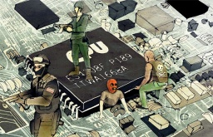
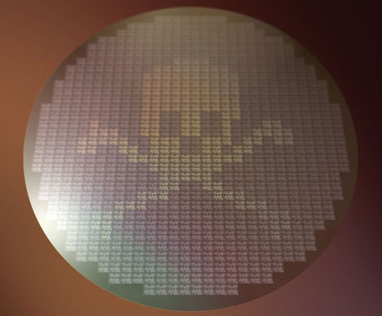
Example Attack
DHS: Imported Consumer Tech Contains Hidden Hacker Attack Tools
Top homeland securities have admitted instances where along with software, hardware components that are being imported from foreign parties and used in different US systems are being compromised and altered to enable easier cyber-attacks.
The Hunt for Kill Switch, IEEE Spectrum 2008
Increasing threat to hardware due to globalization
Extremely difficult to detect kill switches (utilized by enemies to damage/destroy opponent artillery during critical missions) as well as intentional backdoors (to enable remote control of chips without user knowledge), which may have huge consequences
Example: Syrian’s Radar during Israeli attack, French Government using kill switches intentionally as a form of active defense to damage the chips if they fall in hostile hands, and more...

Slide 20
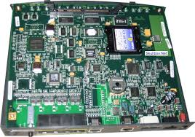
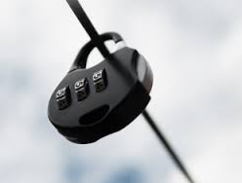

Example Attack
Fake Cisco routers risk "IT subversion”
An internal Federal Bureau of Investigation presentation states that counterfeit Cisco routers imported from China may cause unexpected failures in American networks. The equipment could also leave secure systems open to attack through hidden backdoors.
$76 million fake Cisco routers
Energy Theft Going From Bad to Worse
Tampering with “smart” meters
Oil, electricity, gas, …
$1B loss in CT because of electricity theft

Slide 21
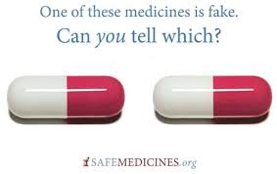
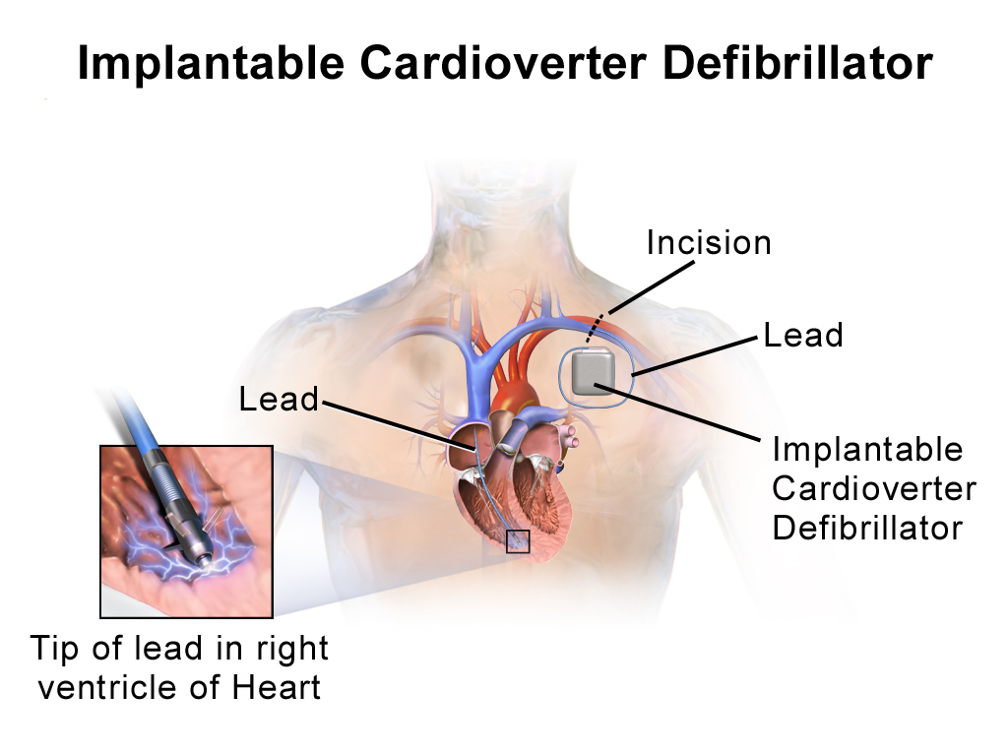
Example Attack
The deadly world of fake medicine – CNN.com
A counterfeit medication or a counterfeit drug is a medication or pharmaceutical product which is produced and sold with the intent to deceptively represent its origin, authenticity or effectiveness.
Medical Device Security
Incorporating security is sometimes considered expensive
Implantable devices: e.g., Heart rate monitor
Incorporating Security could potentially reduce the life-time of the device by 30%
Attacking these device could result in loss of lives

Slide 22
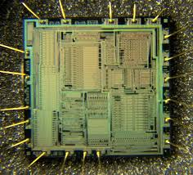
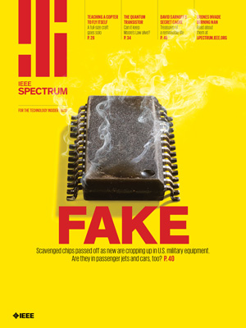
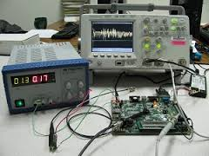
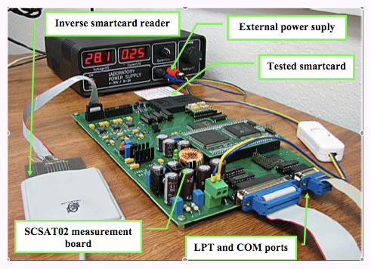
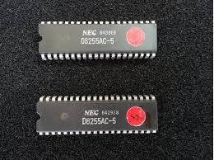
Example Attack
Physical Attacks on Chip IDs
Extracting secret keys
Side-Channel Attacks
Power Analysis, Timing Analysis, EM Analysis
Tampering with Electronic Devices
Captured Drone by Iran
Counterfeit Integrated Circuits
Multi-billion dollar business

Slide 23
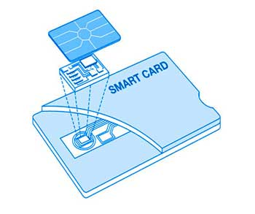
Time for Smart Cards
By the end of 2006, Westerns European countries fully migrated to smart cards
Voting: In Sweden you can vote with your smart card, which serves as a non-repudiation device
Telecommunications: Many cellular phones come with smart cards in Europe and will soon be shipping in the United States.
Mass Transit: British Air relies on rail and air connections more than most airports.
In 2006, ~27M contactless cards were in circulation in US, the number is estimated to top 100M by 2011
E.g., homeland security has required the port workers to have smart ID cards (Jan, 2007)
Entertainment: Most DSS (Digital Satellite Service) dishes in the U.S. have smart cards.

Slide 24
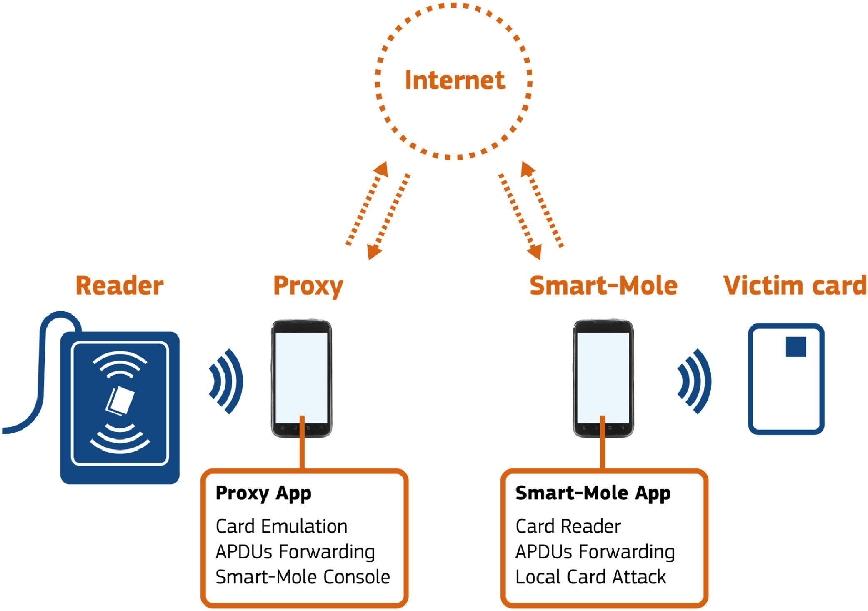
Smart Cards Attack Architecture
The victim card is reached by the attacker through his NFC-equipped mobile phone connected to a NFC-equipped mobile phone in proximity of the card.
The phone close to the victim card can be instructed to run local attacks,
e.g., to extract and return the card access code, and the entire architecture can serve for relay attacks.
Source: Internet

Slide 25
Smart Cards -- Attacks
Access Control: Smart Cards Under Attack - Literally, Ken Warren, Security Magazine, 03/17/2006
Keep Your Enemies Close: Distance Bounding Against Smartcard Relay Attacks, Saar Drimer and Steven J. Murdoch, USENIX SECURITY, 2007
Vulnerability Is Discovered In Security for Smart Cards, John Markoff, NY TIMES, 05/13/2002

Slide 26
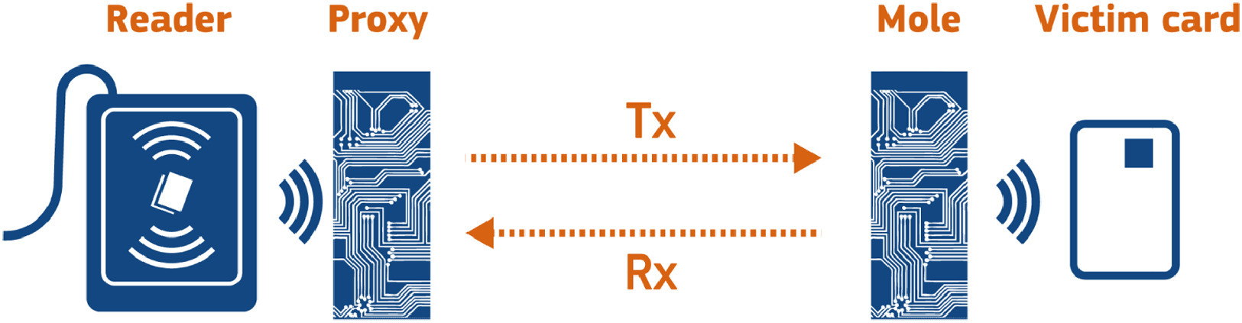
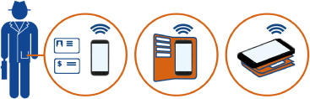
Smart Cards Attacks - Examples
Relay attack against a contactless smart card
Remote contactless cards attack

Slide 27
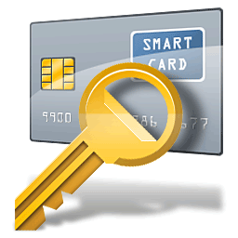
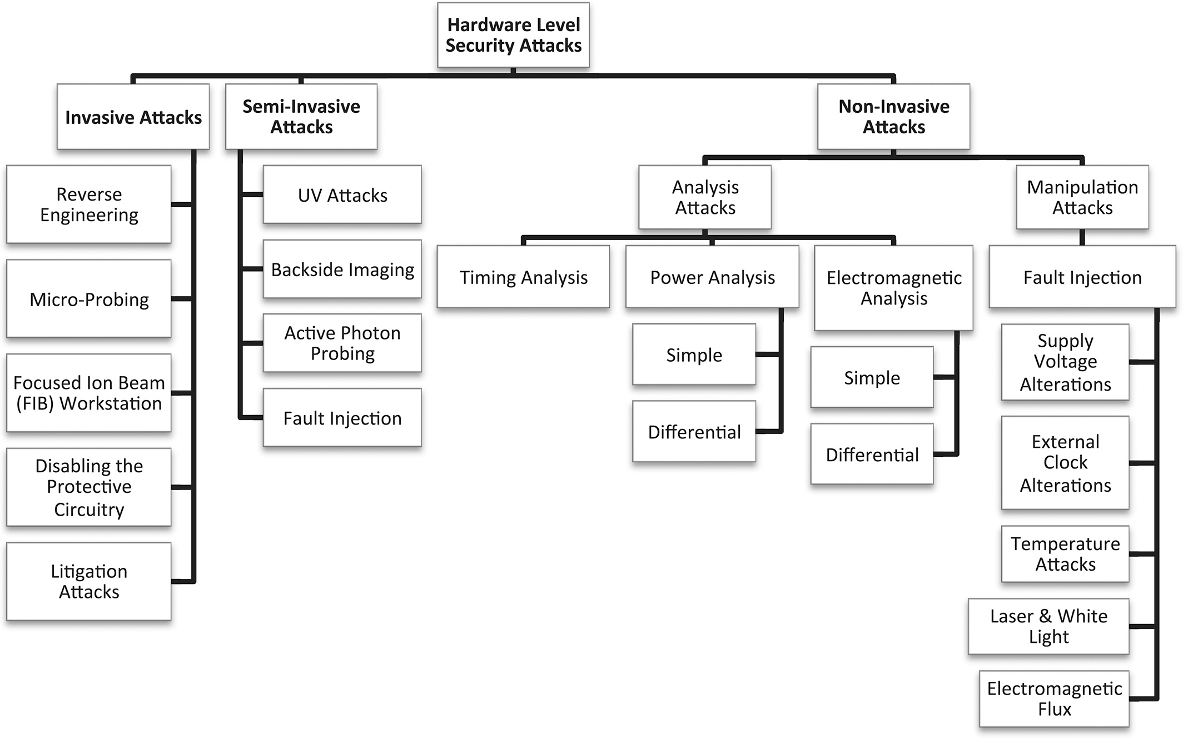
Hardware level security attacks on smart cards
Source: Internet

Slide 28
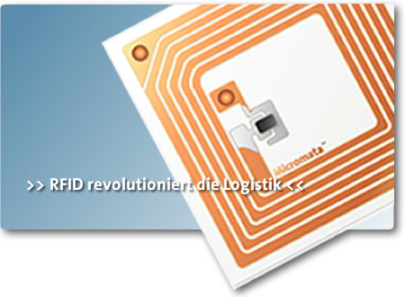
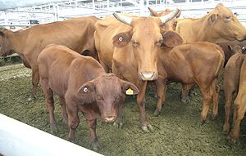
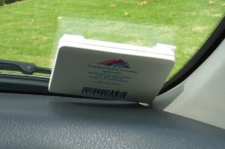
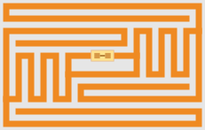
RFIDs
Radio-frequency identification (RFID) is the use of an object (typically referred to as an RFID tag) applied to or incorporated into a product, animal, or person for the purpose of identification and tracking using radio waves.
Most RFID tags contain at least two parts:
An integrated circuit for storing and processing information, modulating and demodulating a radio-frequency (RF) signal, and other specialized functions.
An antenna for receiving and transmitting the signal.
Some are active (battery) and some others are passive

Slide 29
RFIDs
Many applications in securing transactions,
Inventory Control Container / Pallet Tracking
ID Badges and Access Control
Fleet Maintenance Equipment/Personnel Tracking in Hospitals
Parking Lot Access and Control
Car Tracking in Rental Lots
Product Tracking through Manufacturing and Assembly
Challenge: Can we create security mechanisms light enough to be suitable for the RFIDs?
29
Notes:
29

Slide 30
Piracy – Some True Stories…
In 2000, Chen Jin, finished Ph.D. in computer engineering at UT Austin
He went back to China, first to Motorola research and then to Jiaotong University as a faculty
In 2003, he supervised a team that created one of China's first homegrown DSP IC
Chen was named one of China’s brightest young scientists, funded his own lab, got a huge grant from the government
In 2006, it was revealed that he faked the chip, stealing the design from Texas Instruments!
Links to the article: 1, 2

Slide 31
The Athens Affair
In March 8, 2005, Costas Tsalikidis, a 38-year-old Engineer working for Vodafone Greece committed suicide – linked to the scandal!
The next day, the prime minister got notified that his cell phone – and those of many other high-rank officials – were hacked!
Earlier in Jan, investigators had found rogue software installed on the Vodafone Greece by parties unknown
The scheme did not depend on the wireless nature
A breach in keeping keys in a file – Vodafone was fined €76 million December 2006!

Slide 32
Interesting Articles
The Hunt for the Kill Switch, IEEE Spectrum, May 2008
J. Villasenor and M. Tehranipoor, “The Hidden Dangers of Chop Shop Electronics” IEEE Spectrum, Sep. 2013.
M. Tehranipoor, U. Guin, and S. Bhunia, "Invasion of the Hardware Snatchers: Fake Hardware Could Open the Door to Malicious Malware and Critical Failure," IEEE Spectrum, 2017.
S. Quadir, J. Chen, D. Forte, N. Asadi, S. Shahbaz, L. Wang, J. Chandy, and M. Tehranipoor, "A Survey on Chip to System Reverse Engineering," ACM Journal on Emerging Technologies in Computing Systems (JETC), 2015.
M. Alam, M. Tehranipoor, and U. Guin, "TSensors Vision, Infrastructure, and Security Challenges in Trillion Sensor Era," Journal of Hardware and Systems Security (HaSS), 2017.
K. Yang, H. Shen, D. Forte, S. Bhunia, and M. Tehranipoor, "Hardware-Enabled Pharmaceutical Supply Chain Security," ACM Transactions on Design Automation of Electronic Systems (TODAES), 2017.
F. Rahman, B. Shakya, X. Xu, D. Forte, and M. Tehranipoor, "Security Beyond CMOS: Fundamentals, Applications, and Roadmap," IEEE Transactions on VLSI (TVLSI), 2017.

Slide 33

Evolution of Hardware Security and Trust
Prior to 1996: Coating, encapsulation, labeling, taping, … still many companies don’t spend much for securing their hardware
1996: Extracting secret keys using power analysis – started the side-channel signal analysis era
1998: Hardware unique ID
2002: Physically Unclonable Functions (PUFs), True Random Number Generation (TRNG), Hardware tagging
2004-2007: DARPA TRUST, Hardware trust
2008: DARPA IRIS Program – Reverse engineering, tampering, and reliability
2008: Counterfeit ICs
2012: Senate Armed Services – National Defense Authorization Act (NDAA) 2012
2014: DARPA SHIELD – Supply chain security
2015: DARPA LADS
More…

Slide 34
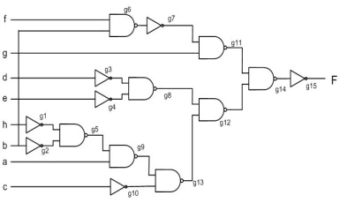
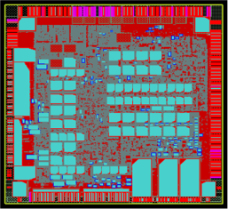
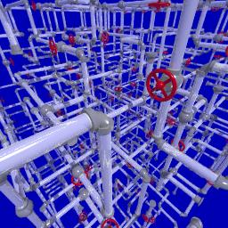
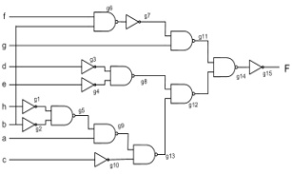



Shift in the Industry’s Business Model
Vertical - one company
Horizontal (Dominant) – Two or more companies
HDL
Synthesis
HDL
Synthesis
Placement
Routing
Place
Economy of scale:
The same fabrication facility serves many fabless companies
Fabrication
Route
Fabrication

Slide 35
Microelectronic Industry Business Model
Notes:
Two points:
protection of design house against foundry
Ic providers against unauthorized

Slide 36
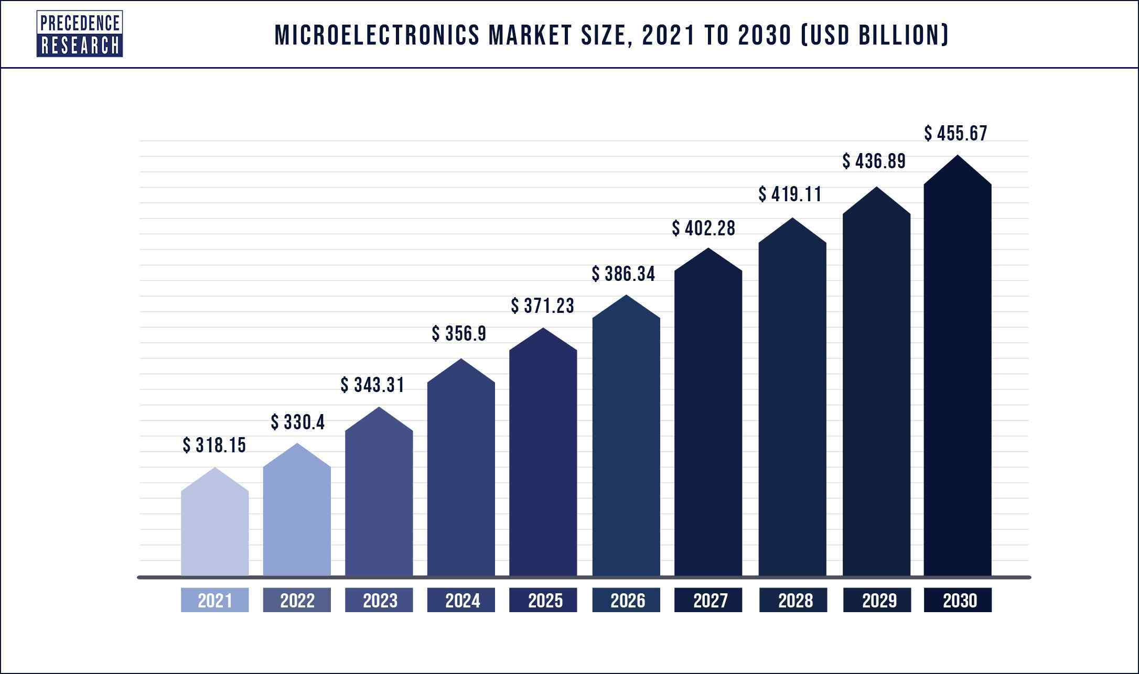
The Global Microelectronics Market Size
The global microelectronics market size was valued at USD 318.15 billion in 2021 and it is expected to surpass around USD 455.67 billion by 2030 with a registered CAGR of 4.1% from 2022 to 2030.
Source: Internet

Slide 37
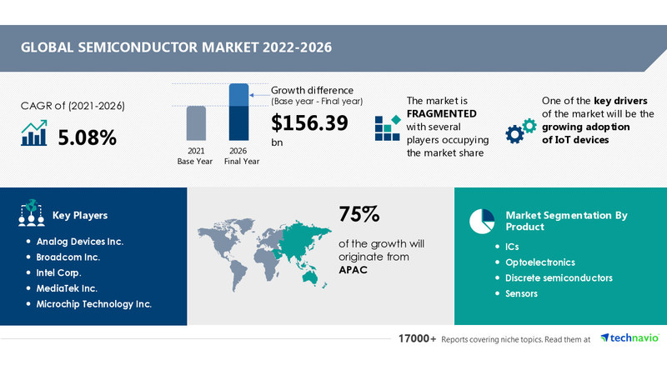
Global Semiconductor Market 2020-2024
Industry Trends, Share, Size, Growth, Opportunity and Forecast
Source: Business Wire

Slide 38
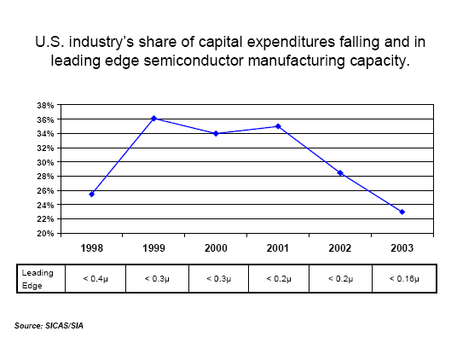
Leading-Edge Technology
The cost of building a full-scale, 300 mm wafer 65nm process chip fabrication plant is about $3bn

Slide 39
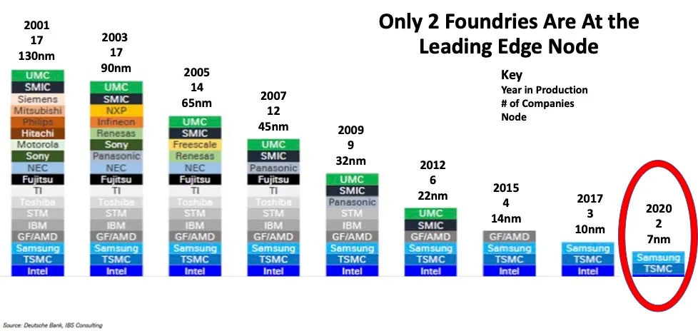
What’s Next – Technology

Slide 40
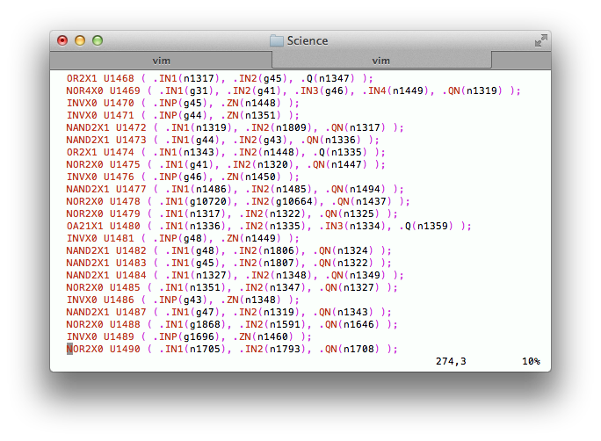
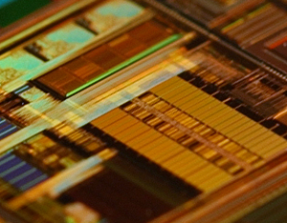
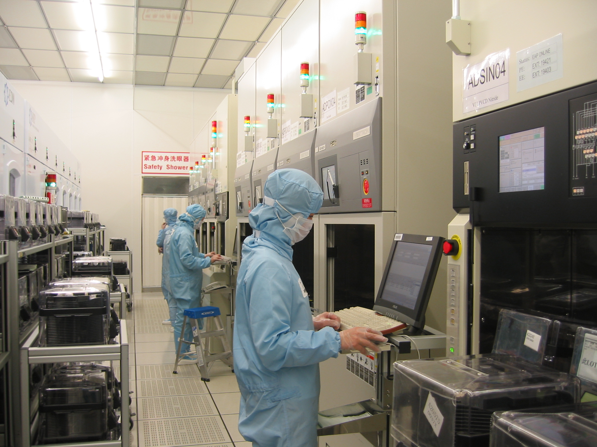
HW Threats
IP Vendor
System Integrator
Manufacturer
Any of these steps can be untrusted

Slide 41
HW Threats
IP Vendor
IP Trust
System Integrator
Manufacture
Untrusted
IC Trust

Slide 42
HW Threats
IP Vendor
System Integrator
IP Piracy
System Trust
Manufacture
Untrusted
IC Trust

Slide 43
HW Threats
IP Vendor
System Integrator
Manufacture
Untrusted Foundry
IC Trust
IC Piracy (Counterfeiting)
Secure Manufacturing Test
Untrusted

Slide 44
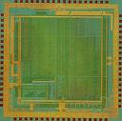
Design Process – Old Way
Design Specification
RTL
RTL->GL
Synthesis
Cell & I/O
Libraries
GL
Layout +
STA
Cell & I/O
GDSII
GDSII
ASIC Manufacturer

Slide 45
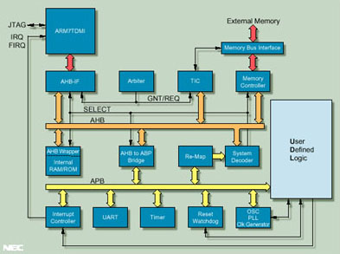
Issues with Third-Party IP Design
System-on-Chip (SoC)
Notes:
Another example: USB-based hardware trojans
FPGA devices

Slide 46
Issues with Third-Party IP Design
Company X
System-on-Chip (SoC)
Company Y
Company Z
Company V
Company W
Notes:
Another example: USB-based hardware trojans
FPGA devices

Slide 47
Issues with Third-Party IP Design
Company X
System-on-Chip (SoC)
These companies are located across the world There is no control on the design process
Company Y
Company Z
Company V
Company W
Notes:
Another example: USB-based hardware trojans
FPGA devices

Slide 48
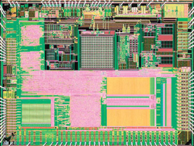
Design Process – New Way
Design Specification
Soft IP
Soft IP
RTL
RTL
RTL
RTL
SOC Design Process
RTL -> GL
Synth + DFT
Cell & I/O
Libraries
Firm IP
Untrusted IPs
GL
GL
Layout
+ STA
Cell & I/O
GDSII
Hard IP
GDSII
GDSII
ASIC Manufacturer

Slide 49

Who Develops the IPs? Who Designs the ICs? Who Fabricates Them?

Slide 50
Who Develops the IPs? Who Designs the ICs? Who Fabricates Them?
Every Where!
Ship to the market
IP
GDSII
Fab
IP
Assembly & Test
DFT
IP

Slide 51

Untrusted System Integrator
Design Specification
Soft IP
Hard IP
RTL
RTL
RTL
RTL
RTL -> GL
Synth + DFT
Cell & I/O
Libraries
GL
GL
Layout
+ STA
Cell & I/O
GDSII
GDSII
GDSII
ASIC Manufacturer

Slide 52
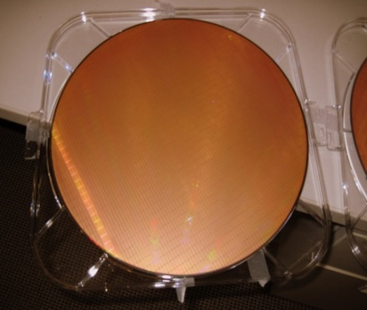
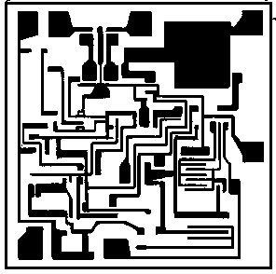
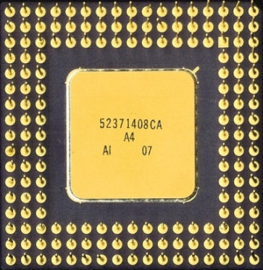
Counterfeiting
GDSII
0100100101110010000100100111000101010100101010000010100111111000000010001000011
IP Owner
Foundry
Assembly
Market
Google image

Slide 53
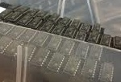
Counterfeiting
IP Owner
GDSII
01001001011100100001001001110001010101001010100000101001111110000
Foundry
Over-produced
ICs
Defective or
Out-of-spec
ICs
Assembly
Market
Google image
Notes:
Low yield wafers
Focus is on untrusted foundry and assembly

Slide 54
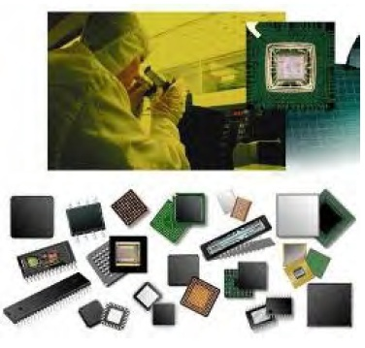
IC Counterfeiting
Most prevalent attack today
Unauthorized production of wafers
It is estimated that counterfeiting is costing semiconductor industry more than several billion dollars per year
Over production
Off-spec parts
Recycled ICs
Defective parts
Cloned ICs

Slide 55
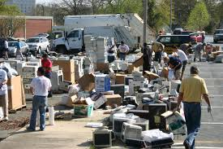
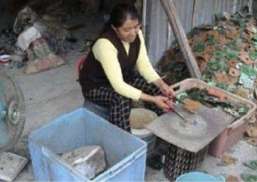




IC Recycling Process
PCBs taken off of electronic systems
ICs taken off of PCBs
A recycling center
Identical:
Appearance, Function, Specification
Critical Application
Refine recycled ICs
Resold as new
Consumer trends suggest that more gadgets are used in much shorter time – more e-waste
Source: Images are taken from google
Notes:
Foundry:
A foundry can add functionality to the design
Detecting Trojans in ICs is very important for IC designers

Slide 56

Supply Chain Vulnerabilities
IP Piracy

Slide 57
Some Basic Definitions
Intellectual property represents the property of your mind or intellect - proprietary knowledge
The four legally defined forms of IP
Patents When you register your invention with the government, you gain the legal right to exclude anyone else from manufacturing or marketing it
Trademarks A trademark is a name, phrase, sound or symbol used in association with services or products
Copyrights Copyright laws protect written or artistic expressions fixed in a tangible medium
Trade secrets A formula, pattern, device or compilation of data that grants the user an advantage over competitors

Slide 58
Some Basic Definitions (Cont’d)
Cryptography:
crypto (secret) + graph (writing)
the science of locks and keys
The keys and locks are mathematical
Underlying every security mechanism, there is a “secret”…
We are going to talk some about the traditional crypto, but we will also show new forms of security based on other forms of HW-based secret

Slide 59

What Does Secure Mean?
It has to do with an asset that has some value – think of what can be an asset!
There is no static definition for “secure”
Depends on what is that you are protecting your asset from
Protection may be sophisticated and unsophisticated
Typically, breach of one security makes the protection agent aware of its shortcoming
Notes:
59
Willie Sutton was asked why he robs banks, he says because “that’s where the money is”. So one can ask why attacking crypto systems, the answer is because that’s where the secret it.

Slide 60

Typical Cycle in Securing a System
Predict potential breaches and vulnerabilities
Consider possible countermeasures, or controls
Either actively pursue identifying a new breach, or wait for a breach to happen
Identify the breach and work out a protected system again
Notes:
60

Slide 61
Computer Security
No matter how sophisticated the protection system is – simple breaches could break-in
A computing system is a collection of hardware (HW), software (SW), storage media, data, and human interacting with them
Security of SW, data, and communication
HW security, is important and challenging
Manufactured ICs are obscure
HW is the platform running SW, storage and data
Tampering can be conducted at many levels
Easy to modify because of its physical nature
Notes:
61

Slide 62

Definitions
Vulnerability: Weakness in the secure system
Threat: Set of circumstances that has the potential to cause loss or harm
Attack: The act of a human exploiting the vulnerability in the system
Computer security aspects
Confidentiality: the related assets are only accessed by authorized parties
Integrity: the asset is only modified by authorized parties
Availability: the asset is accessible to authorized parties at appropriate times
Notes:
62

Slide 63

Hardware Vulnerabilities
Physical Attacks
Trojan Horses
IP Piracy
IC Piracy & Counterfeiting
Backdoors
Tampering
Reverse Engineering
Notes:
63

Slide 64

Adversaries
Individual, group or governments
Pirating the IPs – illegal use of IPs
Inserting backdoors, or malicious circuitries
Implementing Trojan horses
Reverse engineering of ICs
Spying by exploiting IC vulnerabilities
System integrators
Pirating the IPs
Fabrication facilities
Pirating the IPs
Pirating the ICs
Counterfeiting parties
Recycling, cloned, etc.
Notes:
64

Slide 65

Hardware Controls for Secure Systems
Hardware implementations of encryption
Encryption has to do with scrambling to hide
Design locks or physical locks limiting the access
Devices to verify the user identities
Hiding signatures in the design files
Intrusion detection
Hardware boards limiting memory access
Tamper resistant
Policies and procedures
More …
Notes:
65

Slide 66
Embedded Systems Security/IoTs
Security processing adds overhead
Performance and power
Security is challenging in embedded systems/IoTs
Size and power constraints, and operation in harsh environments
Security processing may easily overwhelm the other aspects of the system
Security has become a new design challenge that must be considered at the design time, along with other metrics, i.e., cost, power, area
Notes:
66

Slide 67
Security Requirements in the IoT Era
Notes:
67

Slide 68
Secure Embedded Systems - Design Challenges
Processing gap
Battery gap
Flexibility
Multiple security objectives
Interoperability in different environments
Security processing in different layers
Tamper resistance
Assurance gap
Cost
Notes:
68

Slide 69
Secret
Underlying most security mechanisms or protocols is the notion of a “secret”
Lock and keys
Passwords
Hidden signs and procedures
Physically hidden
Notes:
69

Slide 70

Cryptography – History
Has been around for 2000+ years
In 513 B.C, Histiaeus of Miletus, shaved the slave’s head, tattooed the message on it, let the hair grow
Notes:
70

Slide 71

Cryptography – Pencil & Paper Era
Caesar’s cipher: shifting each letter of the alphabet by a fixed amount!
Easy to break
Cryptoquote: simple substitution cipher, permutations of 26 letters
Using the dictionary and the frequencies, this is also easy to break
Plaintext: THE QUICK BROWN FOX JUMPS OVER THE LAZY DOG
Ciphertext: QEB NRFZH YOLTK CLU GRJMP LSBO QEB IXWV ALD
Notes:
71

Slide 72

Cryptography – Mechanical Era
Around 1900, people realized cryptography has math and stat roots
German’s started a project to create a mechanical device to encrypt messages
Enigma machine → supposedly unbreakable
A few polish mathematicians got a working copy
The machine later sold to Britain, who hired 10,000 people to break the code!
They did crack it! The German messages were transparent to enemies towards the end of war
Estimated that it cut the war length by about a year
British kept it secret until the last working Enigma!
Notes:
72

Slide 73

Cryptography – Mechanical Era
Another German-invented code was Tunny (Lorenz cipher system)
Using a pseudorandom number generator, a seed produced a key stream ks
The key stream xor’d with plain text p to produce cipher c: c=p⊕ks
How was this code cracked by British cryptographers at Bletchley Park in Jan 1942?
A lucky coincidence!
German rotor stream cipher machines used by the German Army during World War II
Notes:
73

Slide 74
Cryptography – Modern Era
First major theoretical development in crypto after WWII was Shannon’s Information Theory
Shannon introduced the one-time pad and presented theoretical analysis of the code
The modern era really started around 1970s
The development was mainly driven by banks and military system requirements
NIST developed a set of standards for the banks,
DES: Data Encryption Standard
Notes:
74

Slide 75
References
http://www.ecs.umass.edu/ece/labs/vlsicad/ece667/ece667.html

Slide 76

Thank You!
Questions?

