Slide 1
EEL4712 Digital Design
(Clock Domain Crossing)

Slide 2
CDC Overview
As modern System-on-Chip (SoC) designs continue to face increasing size and complexity challenges
Multiple asynchronous clock domains have been employed for different I/O interfaces.
A CDC-based (Clock Domain Crossing) design is a design that has one clock asynchronous to, or has a variable phase relation with, another clock.

Slide 3
For example, a clock and its derived clock (via a clock divider) are in the same clock domain because they have a constant phase relationship.
CLK, its inversion, and D1 (derived from CLK) are synchronous to each other.
But, 50MHz and 37MHz clocks (whose phase relationship changes over time) define two separate clock domains.

Slide 4
A clock domain crossing signal is a signal from one clock domain that is sampled by a register in another clock domain.
Within one clock domain, proper static timing analysis (STA) can guarantee that data does not change within clock setup and hold times. When signals pass from one clock domain to another asynchronous domain, there is no way to avoid meta-stability since data can change at any time.

Slide 5
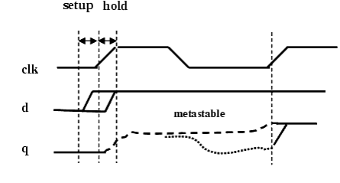
Meta-stability
Every flip-flop (FF) that is used in any design has a specified setup and hold time, or the time in which the data input is not legally permitted to change before and after a sampling clock edge.
Notes:
However, if some input (say d in Figure 2) violates the setup and hold time of a FF, the output of the FF (q in Figure 2) keeps oscillating for an indefinite amount of time. This unstable value may or may not non-deterministically converge to a stable value (either 0 or 1) before the next sampling clock edge arrives.

Slide 6
Notes:
Consider the 1-bit CDC signal adat, which is sampled by register bdat1 in Figure 3. Since adat comes from a different clock domain (aclk), its value can change at any time with respect to bdat1's clock (bclk). If the value of adat changes during bdat1's setup and hold time, the register bdat1 might/might not assume a state between 0 and 1. In this state, the register is said to be meta-stable. A meta-stable register may/may not (unpredictably) settle to either 0 or 1, causing illegal signal values to be propagated throughout the rest of the design.
In a multi-clock design, meta-stability is inevitable, but there are certain design techniques that help to avoid the chance of getting meta-stable. The following section provides an overview of different synchronization techniques.

Slide 7
In a multi-clock design, meta-stability is inevitable, but there are certain design techniques that help to avoid the chance of getting meta-stable.
The main responsibility of a synchronizer is to allow sufficient time such that any meta-sable output can settle down to a stable value in the destination clock domain.
Notes:
Synchronization Techniques
Synchronization of Control Signals with 2-FF Synchronizers
Input Data Stability to Avoid Data Loss
Gray Encoding to Avoid Data Incoherence (For Vector CDC Control Signals)

Slide 8
Synchronization of Control Signals with 2-FF Synchronizers
The most common synchronizer used by designers is two-flip-flop (2-FF) synchronizers. Usually the control signals in a design are synchronized by 2-FF synchronizers.
Even if a 2-FF synchronizer helps to prevent propagation of meta-stable values, for the correct operation of the design, some other issues needs to be tackled.
Notes:
In a 2-FF synchronizer, the first flip-flop samples the asynchronous input signal into the destination clock domain and waits for a full destination clock cycle to permit any meta-stability on the stage-1 output signal to decay, then the stage-1 signal is sampled by the same clock into a second stage flip-flop, with the intended goal that the stage-2 signal is now a stable and valid signal synchronized into the destination clock domain. It is theoretically possible for the stage-1 signal to still be sufficiently meta-stable by the time the signal is clocked into the second stage to cause the stage-2 signal to also go meta-stable.
However, note that the meta-stability is a probabilistic phenomenon. The meta-stable output converges to a stable value with time. Therefore, even if the input to the stage-2 FF still remains meta-stable, the probability that the output of the stage-2 FF will remain meta-stable for a full destination clock cycle is asymptotically close to zero. This calculation of the probability of the time between synchronization failures (MTBF) is a function of multiple variables including the clock frequencies used to generate the input signal and to clock the synchronizing flip-flops. For most synchronization applications, a 2-FF synchronizer is sufficient to remove all likely meta-stability.
Even if a 2-FF synchronizer helps to prevent propagation of meta-stable values, for the correct operation of the design, some other issues needs to be tackled. These issues are explained in the following sections.
Input Data Stability to Avoid Data Loss

Slide 9
Input Data Stability to Avoid Data Loss
Every transition on the input signal needs to be correctly propagated to the destination domain.
The input signal needs to hold its value a minimum amount of time such that there is at least a single destination sampling clock edge, which samples the input value correctly (No setup/hold violation)
Notes:
A synchronizer circuit ensures avoiding propagation of meta-stability into the destination clock domain, but it can't ensure propagation of correct value as the meta-stable signal non-deterministically converges to any stable value (1 or 0). However, for correct operation of the design, every transition on the input signal needs to be correctly propagated to the destination domain. To ensure preventing data loss (losing input transitions), the input signal needs to hold its value a minimum amount of time such that there is at least a single destination sampling clock edge, which samples the input value correctly (No setup/hold violation; Figure 5 gives such an example). This stability condition on the input signal is usually checked by putting assertions. For more information, see the section "Flip-flop Synchronizers".

Slide 10
Gray Encoding to Avoid Data Incoherence
the natural way to transfer a vector control signal is to model each bit of the vector to be separately synchronized by a FF synchronizer.
Sig wants to change its value from "000" to "101" (both indicate valid states). However, it ends up in invalid state “100”.
Notes:
Similar to the case of syncing a single bit control signal, the natural way to transfer a vector control signal is to model each bit of the vector to be separately synchronized by a FF synchronizer. You have already seen that even if you use FF synchronizers, it usually takes more than one cycle to propagate correct input values to the destination domain. Now consider a case where every bit of the vector takes a transition very close to the destination clock edge. Also assume that, by virtue of meta-stability, only some of these transitions are correctly captured by the destination domain in the first cycle. Now, if the bit values of the vector decide the state of the destination domain, after the first cycle, the destination domain may move into an invalid state.
Example - Suppose a vector control signal Sig [2:0] crosses from Domain 1 to Domain 2. Signal Sig also decides the state of Domain 2 and you assume that the value "100" of Sig [2:0] indicates an invalid state for Domain 2. Now, think of a situation, where the signal Sig wants to change its value from "000" to "101" (both indicate valid states). This requires the two bits Sig [0] and Sig [2] to transit simultaneously. Both these transition occurs very close to the destination sampling clock edge (see Fig 6). By virtue of meta-stability, transition on Sig [2] gets captured correctly and the transition on Sig [0] is missed. In this way, in the first cycle of the destination clock, the system moves to state "100" which is invalid.
This case would not have happened, if changing the states of the design requires changing only a single bit of the vector (Sig in this case). In case of a single bit transition, either that transition would be captured in the destination domain or not. This way the design either stays in the previous state or move to a valid state. Therefore, for vector control signals (multi-bit signals, such as address buses), the usual solution is to use a Gray code when crossing a clock domain boundary. A Gray code ensures that only a single bit changes as the bus counts up or down. The presence of gray coding on vector control signal can be checked by using assertions. For more information, see the section "Gray Code Encoding for Vector Control Signals".

Slide 11
Gray Encoding to Avoid Data Incoherence
Use Gray code when crossing a clock domain boundary.
A Gray code ensures that only a single bit changes as the bus counts up or down.
The presence of gray coding on vector control signal can be checked by using assertions. For more information, see the section "Gray Code Encoding for Vector Control Signals".

Slide 12
Synchronization of CDC Data Signals
It is challenging to ensure transfer of data buses from one clock domain to another.
The individual bits of a data bus can change randomly while changing clock boundaries.
Using synchronizers/gray code to handle the passing of data bus is generally unacceptable.
Three common methods
Using MUX based synchronizers.
Using Handshake signals.
Using FIFOs (First In First Out memories) to store data with one clock domain and to retrieve data with another clock domain.

Slide 13
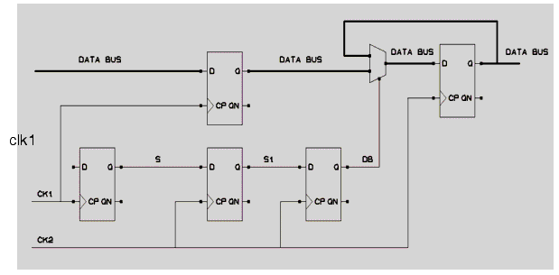
Using MUX based synchronizers

Slide 14
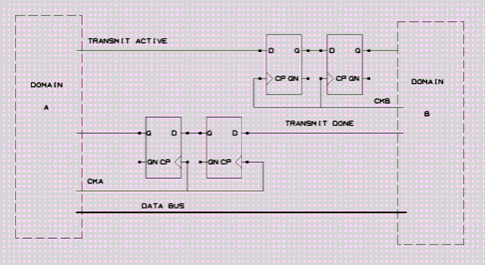
Handshaking Data between Clock Domains
Notes:
ata can be passed between clock domains using a set of handshake control signals, depending on the application and the paranoia of the design engineer. When it comes to handshaking, the more control signals that are used, the longer the latency to pass data from one clock domain to another. The biggest disadvantage in using handshaking is the latency required to pass and recognize all of the handshaking signals for each data word that is transferred. Figure 8 show
or many open-ended data-passing applications, a simple two-line handshaking sequence is sufficient. The sender places data onto a data bus and then synchronizes a "req" signal (request) to the receiving clock domain. When the "req" signal is recognized in the destination clock domain, the receiver clocks the data into a register (the data should have been stable for at least two/three sampling clock edges in the destination clock domain) and then passes an "ack" signal (acknowledgement) through a synchronizer to the sender. When the sender recognizes the synchronized "ack" signal, the sender can change the value being driven onto the data bus.s a typical handshake synchronizer.

Slide 15
Passing Data by FIFO between Clock Domains

Slide 16
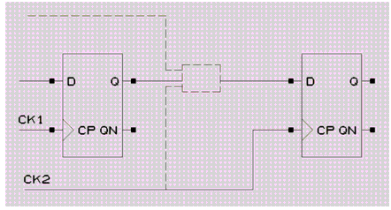
User-defined Synchronizers
Notes:
ometimes, you may specify some cells to be synchronizers. If this cell is found on the path between the FF, the path has to be considered as synchronized. Note that the cell itself may have other inputs than the source flip-flop as shown in the following illustration. The way of specifying a synchronizer is explained in chapter 2, section "Using Tcl Command 'set_cdc_synchronizer'".

Slide 17
Structural Analysis to Identify CDC Signals
The most important task of any CDC structural analyzer is to find out all the signals (CDC) that cross clock boundaries.
Notes:
The most important task of any CDC structural analyzer is to find out all the signals (CDC) that cross clock boundaries. In Leda, rule NTL_CDC01 (For more information, see the section "CDC Ruleset" in chapter 2.) reports all the un-synchronized CDC paths. However a CDC path may be synchronized in the destination clock domain. Thus, identification of synchronization schemes is very important to avoid reporting false CDC reports. Automatic detection of synchronizers is very tough and may depend on the underlying design principle. Therefore, sometime, the designer needs to provide additional information for the underlying synchronization schemes.
Once extraction of information for all the CDC paths (synchronized and un-synchronized) is over, you need to see whether there are structural defects before and after the synchronizers.
For example, it is important that glitches in the driving clock domain not be propagated into the receiving clock domain. Since the flip-flops in the receiving clock domain can sample the signals from the driving clock domain at any point, there is no way through static timing analysis to ensure that the glitch will not be propagated. Figure 11 shows an example of combinational logic (convergence) that could cause a glitch to pass from one clock domain to another.

Slide 18
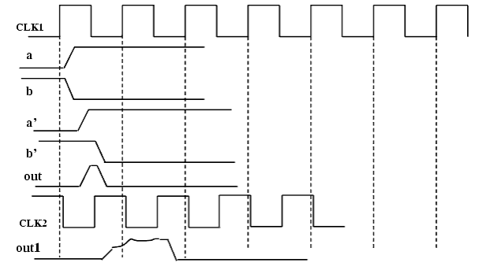
Convergence in the Crossover Path

Slide 19
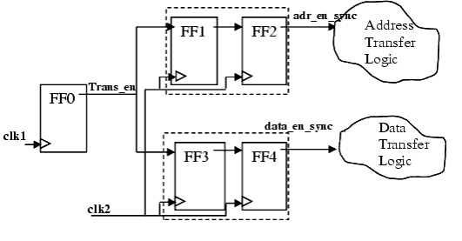
Divergence in the Crossover Path
Design styles which allow divergent logic on a CDC signal to multiple synchronization paths, may cause functional errors.
Notes:
Design styles which allow divergent logic on a CDC signal to multiple synchronization paths, may cause functional errors. As Figure illustrates, a single control signal (Trans_en) from the source clock domain (clk1) is used to activate both the "addr" and "data" transfer unit in the destination clock domain (clk2). The purpose is to enable both the logics at the same time. To model this, fan-outs of Trans_en has been used before the synchronization takes place. However, due to the propagation delay and different meta-stable settling times, the two fan-outs ('addr_en' and 'data_en') could reach the Address and Data transfer logics at different times. Therefore these two logics may start at different time causing functional errors. This type of structure should be avoided by fanning out a single FF synchronized 'common enable' signal to the two transfer logics. Rule NTL_CDC03 detects this issue.

Slide 20
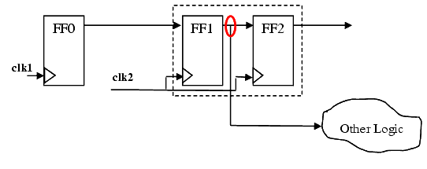
Divergence of Meta-stable Signal
Using a meta-stable signal in a design can be erroneous. Therefore multiple fan-out of the output of the first FF of a FF synchronizer can cause functional errors.

Slide 21
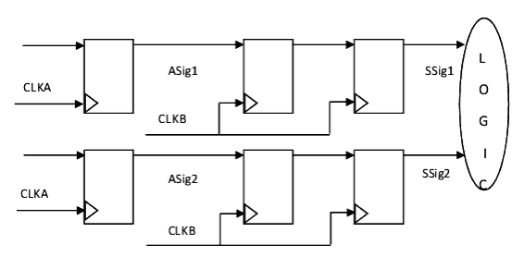
convergence of Synchronized Signals
When a signal goes meta-stable, a synchronizer settles it down, but cannot guarantee the precise number of cycles before the valid signal is available in the receiving clock domain.
Notes:
Synchronization and glitch elimination alone are not enough to ensure reliable transfer of data across clock domains. When a signal goes meta-stable, a synchronizer settles it down, but cannot guarantee the precise number of cycles before the valid signal is available in the receiving clock domain. Therefore, if (1) two independent signals or (2) bits of a multi-bit signal are independently synchronized (using same type of synchronizers or different types of synchronizers), the bits may arrive in the receiving clock domain skewed with respect to one another. A very simple form of re-convergence is shown in the Figure.
Therefore, even when meta-stability does not occur, any pair of bits can get out of synchronization if routing differences and electrical effects cause the two bits to have different delays before reaching their respective synchronizers. It is possible for one synchronizer to sample its input and capture a signal change before the other synchronizer captures the change, at which point the two copies of the signal will be skewed by a cycle and no longer correlated.

Slide 22
Conclusion
A CDC signal is a signal latched by a flip-flop (FF) in one clock domain and sampled in another asynchronous clock domain.
Transferring signals between asynchronous clock domains may lead to setup or hold timing violations of flip-flops.
These violations may cause signals to be meta-stable.
Notes:
This time window is specified as a design parameter precisely to keep a data signal from changing too close to another synchronizing signal that could cause the output to go meta-stable.

Slide 23
Conclusion
Even if synchronizers could eliminate the meta-stability, incorrect use, such as convergence of synchronized signals or improper synchronization protocols, may also result in functional CDC errors.
Functional validation of such SoC designs is one of the most complex and expensive tasks.
Simulation on register transfer level (RTL) is still the most widely used method. However, standard RTL simulation can not model the effect of meta-stability.

Slide 24
References
https://filebox.ece.vt.edu/~athanas/4514/ledadoc/html/pol_cdc.html

Slide 25
Questions?

