Slide 1
EEL4712 Digital Design
(MIPS Processor Performance)

Slide 2
Processor Performance
Program Execution Time
= (#instructions)*(cycles/instruction)*(seconds/cycle)
= # instructions x CPI x TC

Slide 3
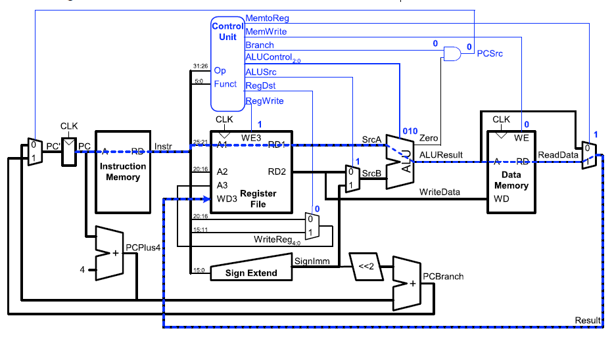
Single-Cycle Performance
TC is limited by the critical path (lw)

Slide 4
Single-Cycle Performance
Single-cycle critical path:
Tc = tpcq_PC + tmem + max(tRFread, tsext + tmux) + tALU +tmem + tmux + tRFsetup
In most implementations, limiting paths are:
memory, ALU, register file.
Tc = tpcq_PC + 2*tmem + tRFread + tmux + tALU + tRFsetup

Slide 5
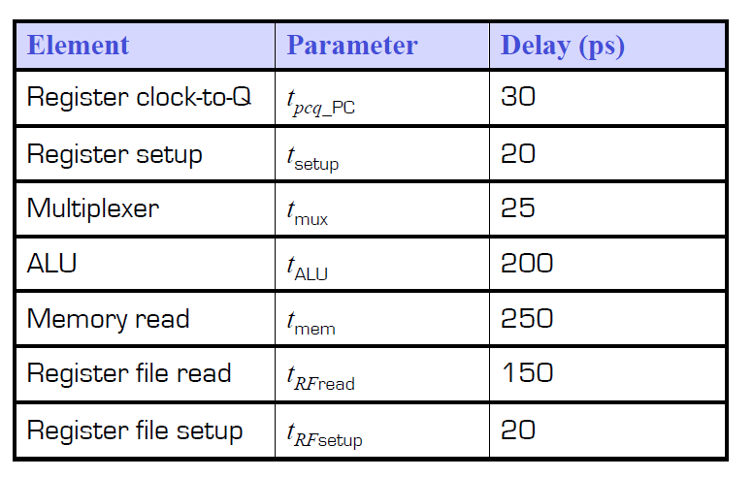
Single-Cycle Performance Example

Slide 6
Single-Cycle Performance Example
TC= tpcq_PC + 2tmem + tRFread + tmux + tALU + tRFsetup = [30 + 2(250) + 150 + 25 + 200 + 20] ps
= 925 ps

Slide 7
Single-Cycle Performance Example
For a program with 100 billion instructions executing on a singlecycle MIPS processor
Execution Time = # instructions x CPI x TC
= (100 × 109)(1)(925 × 10-12 s) = = 92.5 seconds

Slide 8
How to make the performance better?

Slide 9
Pipelined MIPS Processor
Temporal parallelism
Divide single-cycle processor into 5 stages:
Fetch
Decode
Execute
Memory
Writeback
Add pipeline registers between stages

Slide 10
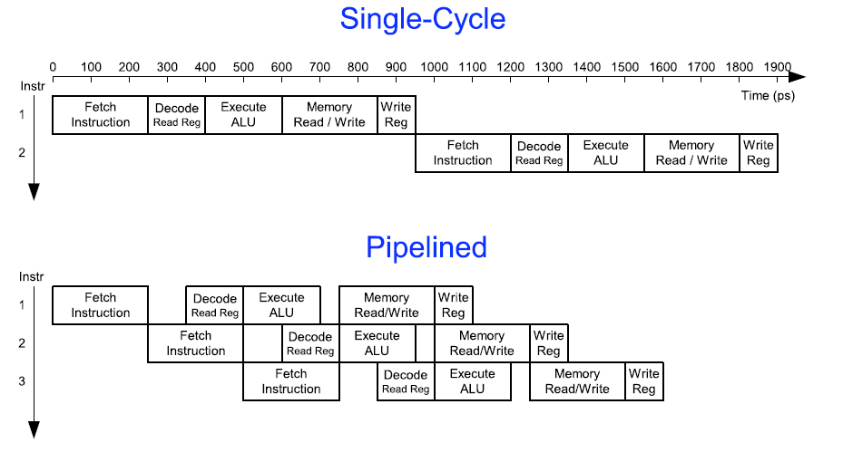
Single-Cycle vs. Pipelined Performance

Slide 11
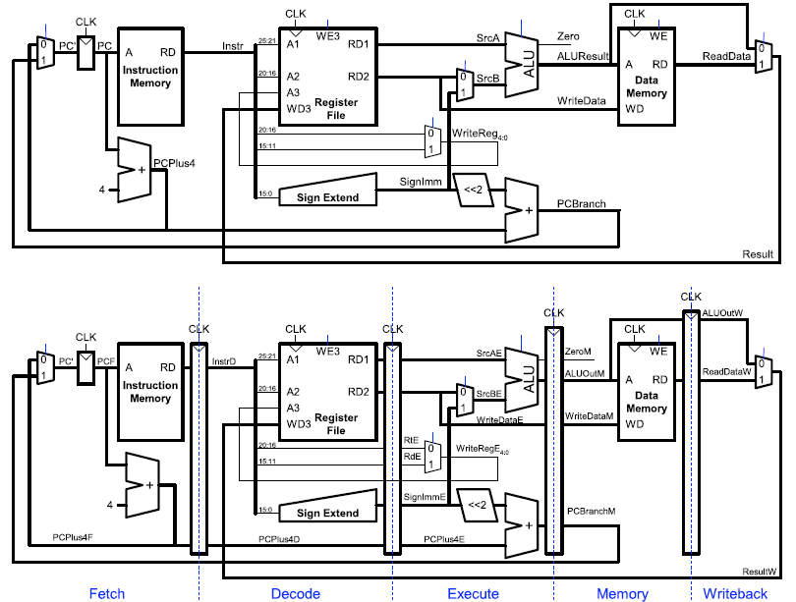
Single-Cycle and Pipelined Datapath

Slide 12
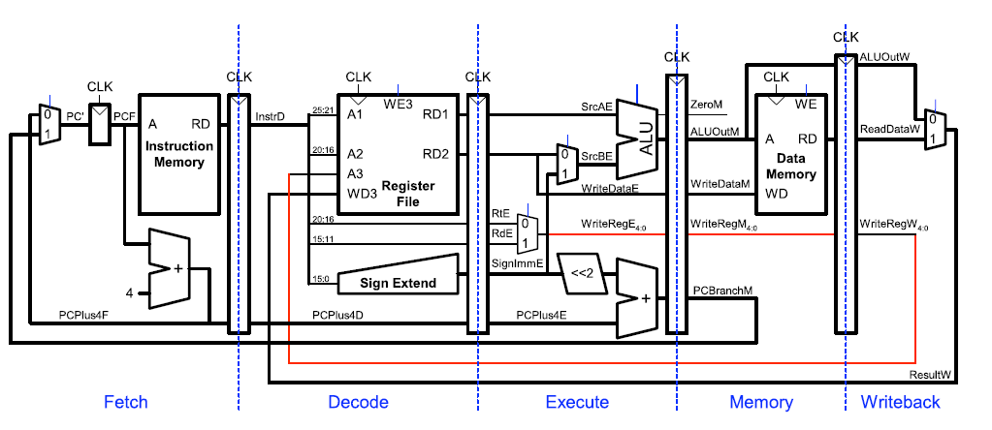
Corrected Pipelined Datapath
WriteReg must arrive at the same time as Result

Slide 13
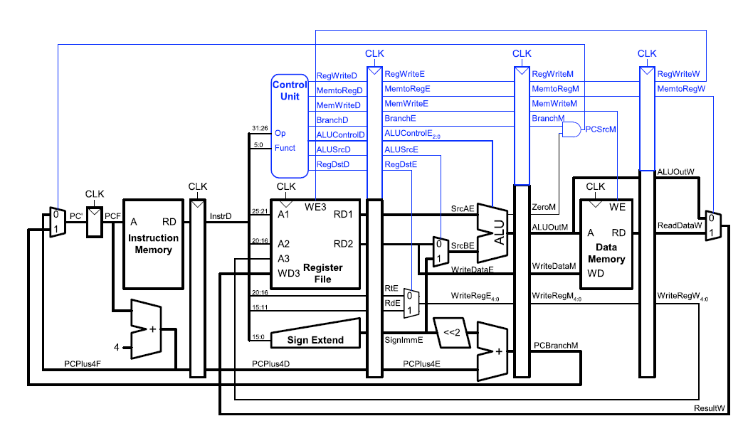
Pipelined Control
Same control unit as single-cycle processor Control delayed to proper pipeline stage

Slide 14
Pipeline Hazards
Occurs when an instruction depends on results from previous instruction that hasn’t completed.
Types of hazards:
Data hazard: register value not written back to register file yet
Control hazard: next instruction not decided yet (caused by branches)

Slide 15
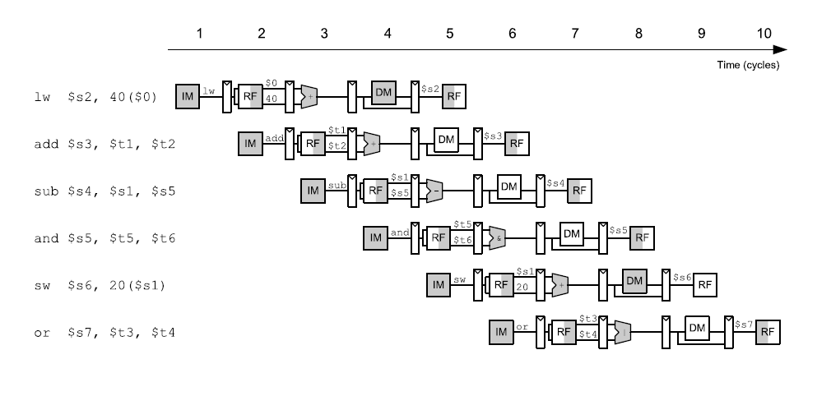
Pipelining Abstraction

Slide 16
References
http://www-inst.eecs.berkeley.edu/~cs150/sp12/agenda/lec/lec07-MIPS.pdf
https://web.cse.ohio-state.edu/~crawfis.3/cse675-02/Slides/CSE675_02a_MIPS-ISA.pdf
https://en.wikipedia.org/wiki/MIPS_architecture
http://homepage.divms.uiowa.edu/~ghosh/6016.90.pdf

Slide 17
Questions?

