Slide 1
EEL4712 Digital Design

Slide 2
Aliases

Slide 3
Aliases
Syntax:
ALIAS name : type := expression;
Example:
signal IR : std_logic_vector(31 downto 0);
alias IR_opcode : std_logic_vector(5 downto 0) is IR(31 downto 26);
alias IR_reg1_addr : std_logic_vector(4 downto 0) is IR(25 downto 21);
alias IR_reg2_addr : std_logic_vector(4 downto 0) is IR(20 downto 16);

Slide 4
Constants

Slide 5
Constants
Syntax:
CONSTANT name : type := value;
Examples:
CONSTANT init_value : STD_LOGIC_VECTOR(3 downto 0) := "0100";
CONSTANT ANDA_EXT : STD_LOGIC_VECTOR(7 downto 0) := X"B4";
CONSTANT counter_width : INTEGER := 16;
CONSTANT buffer_address : INTEGER := 16#FFFE#;
CONSTANT clk_period : TIME := 20 ns;
CONSTANT strobe_period : TIME := 333.333 ms;

Slide 6
Constants - Features
Constants can be declared in a
PACKAGE, ENTITY, ARCHITECTURE
When declared in a PACKAGE, the constant
is truly global, for the package can be used
in several entities.
When declared in an ARCHITECTURE, the
constant is local, i.e., it is visible only within this architecture.
When declared in an ENTITY declaration, the constant
can be used in all architectures associated with this entity.

Slide 7
Packages

Slide 8
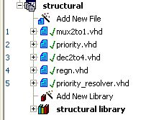
Explicit Component Declaration versus Package
Explicit component declaration is when you declare components in main code
When have only a few component declarations, this is fine
When have many component declarations, use packages for readability
Packages also help with portability and sharing of libraries among many users in a company
Remember, the actual instantiations always take place in main code
Only the declarations can be in main code or package

Slide 9
METHOD #2: Package component declaration
Components declared in package
Actual instantiations and port maps always in main code

Slide 10
Packages
Instead of declaring all components can declare all components in a PACKAGE, and INCLUDE the package once
This makes the top-level entity code cleaner
It also allows that complete package to be used by another designer
A package can contain
Components
Functions, Procedures
Types, Constants

Slide 11
Package – example (1)
LIBRARY ieee ;
USE ieee.std_logic_1164.all ;
PACKAGE GatesPkg IS
COMPONENT mux2to1
PORT (w0, w1, s : IN STD_LOGIC ;
f : OUT STD_LOGIC ) ;
END COMPONENT ;
COMPONENT priority
PORT (w : IN STD_LOGIC_VECTOR(3 DOWNTO 0) ;
y : OUT STD_LOGIC_VECTOR(1 DOWNTO 0) ;
z : OUT STD_LOGIC ) ;
END COMPONENT ;

Slide 12
Package – example (2)
COMPONENT dec2to4
PORT (w : IN STD_LOGIC_VECTOR(1 DOWNTO 0) ;
En : IN STD_LOGIC ;
y : OUT STD_LOGIC_VECTOR(0 TO 3) ) ;
END COMPONENT ;
COMPONENT regn
GENERIC ( N : INTEGER := 8 ) ;
PORT ( D : IN STD_LOGIC_VECTOR(N-1 DOWNTO 0) ;
Enable, Clock : IN STD_LOGIC ;
Q : OUT STD_LOGIC_VECTOR(N-1 DOWNTO 0) ) ;
END COMPONENT ;

Slide 13
Package – example (3)
constant ADDAB : std_logic_vector(3 downto 0) := "0000";
constant ADDAM : std_logic_vector(3 downto 0) := "0001";
constant SUBAB : std_logic_vector(3 downto 0) := "0010";
constant SUBAM : std_logic_vector(3 downto 0) := "0011";
constant NOTA : std_logic_vector(3 downto 0) := "0100";
constant NOTB : std_logic_vector(3 downto 0) := "0101";
constant NOTM : std_logic_vector(3 downto 0) := "0110";
constant ANDAB : std_logic_vector(3 downto 0) := "0111";
END GatesPkg;

Slide 14
Package usage (1)
LIBRARY ieee ;
USE ieee.std_logic_1164.all ;
USE work.GatesPkg.all;
ENTITY priority_resolver1 IS
PORT (r : IN STD_LOGIC_VECTOR(5 DOWNTO 0) ;
s : IN STD_LOGIC_VECTOR(1 DOWNTO 0) ;
clk : IN STD_LOGIC;
en : IN STD_LOGIC;
t : OUT STD_LOGIC_VECTOR(3 DOWNTO 0) ) ;
END priority_resolver1;
ARCHITECTURE structural OF priority_resolver1 IS
SIGNAL p : STD_LOGIC_VECTOR (3 DOWNTO 0) ;
SIGNAL q : STD_LOGIC_VECTOR (1 DOWNTO 0) ;
SIGNAL z : STD_LOGIC_VECTOR (3 DOWNTO 0) ;
SIGNAL ena : STD_LOGIC ;

Slide 15
Package usage (2)
BEGIN
u1: mux2to1 PORT MAP ( w0 => r(0) ,w1 => r(1),s => s(0), f => p(0));
u2: mux2to1 PORT MAP ( w0 => r(4) ,w1 => r(5),s => s(1),f => p(3));
u3: priority PORT MAP (w => p, y => q, z => ena);
u4: dec2to4 PORT MAP ( w => q, En => ena, y => z);
u5: regn GENERIC MAP ( N => 4)
PORT MAP ( D => z , Enable => En ,Clock => Clk, Q => t );
p(1) <= r(2);
p(2) <= r(3);
END structural;

Slide 16
Mixing Design Styles Inside
of an Architecture

Slide 17
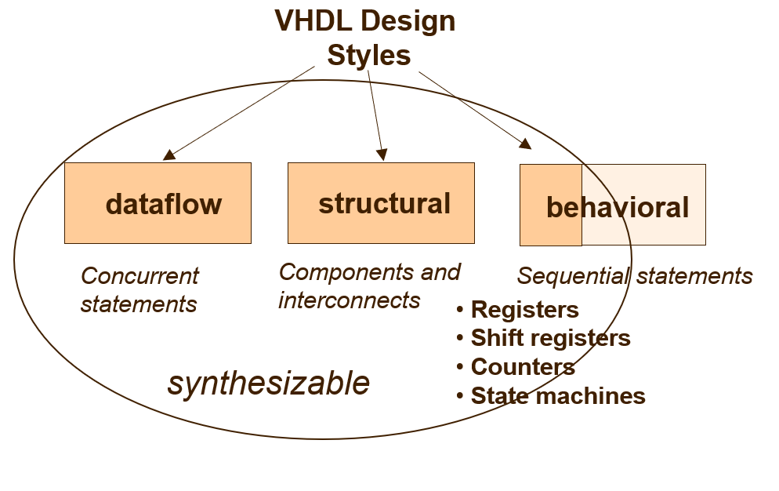
VHDL Design Styles

Slide 18
Mixed Style Modeling
architecture ARCHITECTURE_NAME of ENTITY_NAME is
Here you can declare signals, constants, types, etc.
Component declarations
begin
Concurrent statements:
Concurrent simple signal assignment
Conditional signal assignment
Selected signal assignment
Generate statement
Component instantiation statement
Process statement
inside process you can use only sequential statements
end ARCHITECTURE_NAME;
Concurrent Statements

Slide 19
PRNG Example (1)
library IEEE;
use IEEE.STD_LOGIC_1164.all;
use work.prng_pkg.all;
ENTITY PRNG IS
PORT( Coeff : in std_logic_vector(4 downto 0);
Load_Coeff : in std_logic;
Seed : in std_logic_vector(4 downto 0);
Init_Run : in std_logic;
Clk : in std_logic;
Current_State : out std_logic_vector(4 downto 0));
END PRNG;
ARCHITECTURE mixed OF PRNG is
signal Ands : std_logic_vector(4 downto 0);
signal Sin : std_logic;
signal Coeff_Q : std_logic_vector(4 downto 0);
signal Shift5_Q : std_logic_vector(4 downto 0);

Slide 20
PRNG Example (2)
-- Data Flow
G: FOR I IN 0 TO 4 GENERATE
Ands(I) <= Coeff_Q(I) AND Shift5_Q(I);
END GENERATE;
Sin <= Ands(0) XOR Ands(1) XOR Ands(2) XOR Ands(3) XOR Ands(4);
Current_State <= Shift5_Q;
-- Behavioral
Coeff_Reg: PROCESS(Clk)
BEGIN
IF Clk'EVENT and Clk = '1' THEN
IF Load_Coeff = '1' THEN
Coeff_Q <= Coeff;
END IF;
END IF;
END PROCESS;
-- Structural
Shift5_Reg : Shift5 PORT MAP ( D => Seed,
Load => Init_Run,
Sin => Sin,
Clock => Clk,
Q => Shift5_Q);
END mixed;

Slide 21
References
https://ece.gmu.edu/coursewebpages/ECE/ECE545/F18/viewgraphs/ECE545_lecture_8_regular.pdf

Slide 22
Questions?

