Slide 1

EEL4712 Digital Design
(Sequential-Circuit Building Blocks-2)

Slide 2
Counters

Slide 3
2-bit up-counter with synchronous reset
LIBRARY ieee ;
USE ieee.std_logic_1164.all ;
USE ieee.std_logic_unsigned.all ;
ENTITY upcount IS
PORT ( Clear, Clock : IN STD_LOGIC ;
Q : OUT STD_LOGIC_VECTOR(1 DOWNTO 0) ) ;
END upcount ;
ARCHITECTURE behavioral OF upcount IS
SIGNAL Count : std_logic_vector(1 DOWNTO 0);
BEGIN
upcount: PROCESS ( Clock )
BEGIN
IF rising_edge(Clock) THEN
IF Clear = '1' THEN
Count <= "00" ;
ELSE
Count <= Count + 1 ;
END IF ;
END IF;
END PROCESS;
Q <= Count;
END behavioral;
Clear
2
Q
upcount
Clock

Slide 4
4-bit up-counter with asynchronous reset (1)
LIBRARY ieee ;
USE ieee.std_logic_1164.all ;
USE ieee.std_logic_unsigned.all ;
ENTITY upcount_ar IS
PORT ( Clock, Resetn, Enable : IN STD_LOGIC ;
Q : OUT STD_LOGIC_VECTOR (3 DOWNTO 0)) ;
END upcount_ar ;
Enable
4
Q
Clock
upcount
Resetn

Slide 5
4-bit up-counter with asynchronous reset (2)
ARCHITECTURE behavioral OF upcount _ar IS
SIGNAL Count : STD_LOGIC_VECTOR (3 DOWNTO 0) ;
BEGIN
PROCESS ( Clock, Resetn )
BEGIN
IF Resetn = '0' THEN
Count <= "0000" ;
ELSIF rising_edge(Clock) THEN
IF Enable = '1' THEN
Count <= Count + 1 ;
END IF ;
END IF ;
END PROCESS ;
Q <= Count ;
END behavioral ;
Enable
4
Q
Clock
upcount
Resetn

Slide 6
Shift Registers

Slide 7
Shift Register
Q(3)
Q(2)
Q(1)
Q(0)
Sin
D
Q
D
Q
D
Q
D
Q
Clock
Enable
Notes:
In digital circuits, a shift register is a cascade of flip flops, sharing the same clock, in which the output of each flip-flop is connected to the "data" input of the next flip-flop in the chain, resulting in a circuit that shifts by one position the "bit array" stored in it, "shifting in" the data present at its input and 'shifting out' the last bit in the array, at each transition of the clock input.

Slide 8
Shift Register With Parallel Load
Load
D(3)
D(2)
D(1)
D(0)
Sin
D
Q
D
Q
D
Q
D
Q
Clock
Enable
Q(3)
Q(2)
Q(1)
Q(0)

Slide 9
4-bit shift register with parallel load (1)
LIBRARY ieee ;
USE ieee.std_logic_1164.all ;
ENTITY shift4 IS
PORT ( D : IN STD_LOGIC_VECTOR(3 DOWNTO 0) ;
Enable : IN STD_LOGIC ;
Load : IN STD_LOGIC ;
Sin : IN STD_LOGIC ;
Clock : IN STD_LOGIC ;
Q : OUT STD_LOGIC_VECTOR(3 DOWNTO 0) ) ;
END shift4 ;
4
Enable
4
D
Q
Load
Sin
shift4
Clock

Slide 10
4-bit shift register with parallel load (2)
ARCHITECTURE behavioral OF shift4 IS
SIGNAL Qt : STD_LOGIC_VECTOR(3 DOWNTO 0);
BEGIN
PROCESS (Clock)
BEGIN
IF rising_edge(Clock) THEN
IF Load = '1' THEN
Qt <= D ;
ELSIF Enable = ‘1’ THEN
Qt(0) <= Qt(1) ;
Qt(1) <= Qt(2);
Qt(2) <= Qt(3) ;
Qt(3) <= Sin;
END IF ;
END IF ;
END PROCESS ;
Q <= Qt;
END behavioral ;
4
Enable
4
D
Q
Load
Sin
shift4
Clock

Slide 11
4-bit shift register with parallel load (2)
ARCHITECTURE behavioral OF shift4 IS
SIGNAL Qt : STD_LOGIC_VECTOR(3 DOWNTO 0);
BEGIN
PROCESS (Clock)
BEGIN
IF rising_edge(Clock) THEN
IF Load = '1' THEN
Qt <= D ;
ELSIF Enable = ‘1’ THEN
Qt <= Sin & Qt(3 downto 1); END IF ;
END IF ;
END PROCESS ;
Q <= Qt;
END behavioral ;
4
Enable
4
D
Q
Load
Sin
shift4
Clock

Slide 12
N-bit shift register with parallel load (1)
LIBRARY ieee ;
USE ieee.std_logic_1164.all ;
ENTITY shiftn IS
GENERIC ( N : INTEGER := 8 ) ;
PORT ( D : IN STD_LOGIC_VECTOR(N-1 DOWNTO 0) ;
Enable : IN STD_LOGIC ;
Load : IN STD_LOGIC ;
Sin : IN STD_LOGIC ;
Clock : IN STD_LOGIC ;
Q : OUT STD_LOGIC_VECTOR(N-1 DOWNTO 0) ) ;
END shiftn ;
N
Enable
N
D
Q
Load
Sin
shiftn
Clock

Slide 13
N-bit shift register with parallel load (2)
ARCHITECTURE behavioral OF shiftn IS
SIGNAL Qt: STD_LOGIC_VECTOR(N-1 DOWNTO 0);
BEGIN
PROCESS (Clock)
BEGIN
IF rising_edge(Clock) THEN
IF Load = '1' THEN
Qt <= D ;
ELSIF Enable = ‘1’ THEN
Genbits: FOR i IN 0 TO N-2 LOOP
Qt(i) <= Qt(i+1) ;
END LOOP ;
Qt(N-1) <= Sin ;
END IF;
END IF ;
END PROCESS ;
Q <= Qt;
END behavior al;
N
Enable
N
D
Q
Load
Sin
shiftn
Clock

Slide 14
N-bit shift register with parallel load (2)
ARCHITECTURE behavioral OF shiftn IS
SIGNAL Qt: STD_LOGIC_VECTOR(N-1 DOWNTO 0);
BEGIN
PROCESS (Clock)
BEGIN
IF rising_edge(Clock) THEN
IF Load = '1' THEN
Qt <= D ;
ELSIF Enable = ‘1’ THEN
Qt <= Sin & Qt(N-1 downto 1);
END IF;
END IF ;
END PROCESS ;
Q <= Qt;
END behavior al;
N
Enable
N
D
Q
Load
Sin
shiftn
Clock

Slide 15
Generic Component
Instantiation

Slide 16
N-bit register with enable
LIBRARY ieee ;
USE ieee.std_logic_1164.all ;
ENTITY regn IS
GENERIC ( N : INTEGER := 8 ) ;
PORT ( D : IN STD_LOGIC_VECTOR(N-1 DOWNTO 0) ;
Enable, Clock : IN STD_LOGIC ;
Q : OUT STD_LOGIC_VECTOR(N-1 DOWNTO 0) ) ;
END regn ;
ARCHITECTURE Behavior OF regn IS
BEGIN
PROCESS (Clock)
BEGIN
IF (Clock'EVENT AND Clock = '1' ) THEN
IF Enable = '1' THEN
Q <= D ;
END IF ;
END IF;
END PROCESS ;
END Behavior ;
N
Enable
N
D
Q
Clock
regn

Slide 17
Instantiation
COMPONENT regn
GENERIC ( N : INTEGER := 8 ) ;
PORT ( D : IN STD_LOGIC_VECTOR(N-1 DOWNTO 0) ;
Enable, Clock : IN STD_LOGIC ;
Q : OUT STD_LOGIC_VECTOR(N-1 DOWNTO 0) ) ;
END COMPONENT ;
Component declaration before beginning of an architecture
u: regn GENERIC MAP (N => 4)
PORT MAP (D => z ,
Enable => En ,
Clock => Clk,
Q => t );
Instantiation afre beginning of an architecture

Slide 18
Finite State Machines

Slide 19
Structure of a Typical Digital System

Slide 20
Controller (Control Unit)
Controls data movements in the Datapath by
switching multiplexers and enabling or disabling resources
  Example: enable signals for registers
  Example: select signals for muxes
Provides signals to activate various processing tasks in the Datapath
Determines the sequence of operations performed by the Datapath
Follows Some ‘Program’ or Schedule

Slide 21
Programmable vs. Non-Programmable Controller
Controller can be programmable or non-programmable
Programmable
  Has a program counter which points to the next instruction
  Instructions are held in a RAM or ROM
  Microprocessor is an example of a programmable controller
Non-Programmable
  Once designed, implements the same functionality
  Another term is a “hardwired state machine,” or “hardwired
  FSM,” or “hardwired instructions”
  In this lecture, we will be focusing on nonprogrammable controllers.

Slide 22
Finite State Machines
Digital Systems and especially their Controllers can be described as Finite State Machines (FSMs)
An FSM is used to model a system that transits among a finite number of internal states.
The transitions depend on the current state and external input.
The main application of an FSM is to act as the controller of a medium to large digital system
Design of FSMs involves
  Defining states
  Defining next state and output functions
  Optimization / minimization
Manual optimization/minimization is practical for small FSMs only

Slide 23
Moore FSM
Output is a function of the state only

Slide 24
State Diagrams: Moore Machine

Slide 25
Moore FSM - Example 1
Moore FSM that Recognizes Sequence “10”

Slide 26
State Diagrams: Mealy Machine
Output is a function of the state and inputs

Slide 27
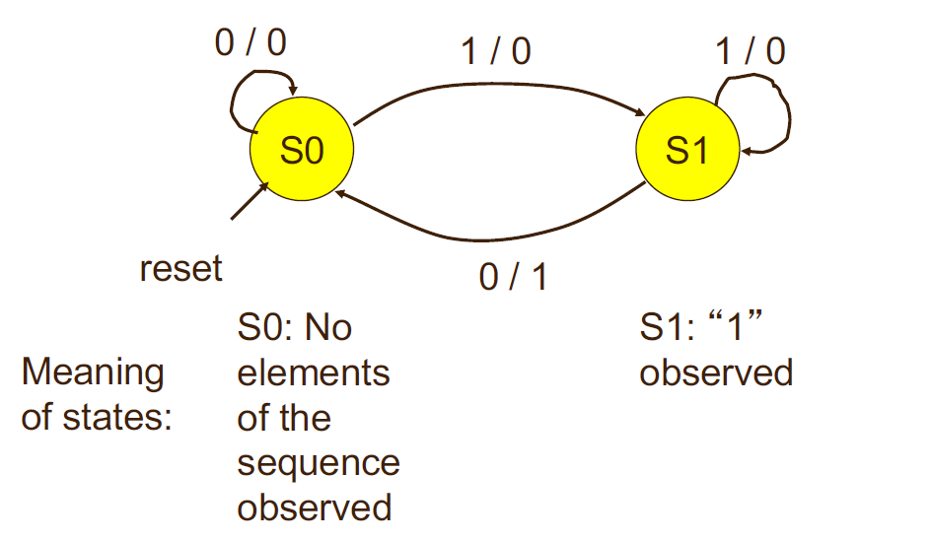
Mealy FSM – Example 1
Mealy FSM that recognizes sequence “10”

Slide 28
Moore & Mealy FSMs without Delays

Slide 29
Moore & Mealy FSMs with Delays

Slide 30
Moore vs. Mealy FSM (2)
Mealy FSM Computes Outputs as soon as Inputs Change
  Mealy FSM responds one clock cycle sooner than equivalent Moore FSM
Moore FSM Has No Combinational Path
Between Inputs and Outputs
  Moore FSM is less likely to affect the critical path of the entire circuit

Slide 31
Which Way to Go?

Slide 32
Mixing Design Styles
Inside of an Architecture

Slide 33
VHDL Design Styles
VHDL Design
Styles
dataflow
structural
behavioral
Concurrent
statements
Components and
interconnects
Sequential statements
Registers
Shift registers
Counters
State machines
synthesizable

Slide 34
Mixed Style Modeling
  architecture ARCHITECTURE_NAME of ENTITY_NAME is
  Here you can declare signals, constants, functions, procedures…
  Component declarations
  begin
  Concurrent statements:
    Concurrent simple signal assignment
    Conditional signal assignment
    Selected signal assignment
    Generate statement
    Component instantiation statement
    Process statement
      inside process you can use only sequential statements
  end ARCHITECTURE_NAME;
Concurrent Statements

Slide 35
Sequential Logic Synthesis
for
Beginners

Slide 36
For Beginners
Use processes with very simple structure only
to describe
- registers
- shift registers
- counters
- state machines.
Use examples discussed in class as a template.
Create generic entities for registers, shift registers, and
counters, and instantiate the corresponding components in
a higher level circuit using GENERIC MAP PORT MAP.
Supplement sequential components with
combinational logic described using concurrent statements.

Slide 37
Sequential Logic Synthesis
for
Intermediates

Slide 38
For Intermmediates
Use Processes with IF and CASE statements only. Do not use LOOPS or VARIABLES.
Sensitivity list of the PROCESS should include only signals that can by themsleves change the outputs of the sequential circuit (typically, clock and asynchronous set or reset)
Do not use PROCESSes without sensitivity list
(they can be synthesizable, but make simulation inefficient)

Slide 39
For Intermmediates (2)
Given a single signal, the assignments to this signal should
only be made within a single process block in order to avoid
possible conflicts in assigning values to this signal.
Process 1: PROCESS (a, b)
BEGIN
y <= a AND b;
END PROCESS;
Process 2: PROCESS (a, b)
BEGIN
y <= a OR b;
END PROCESS;

Slide 40
Poor Design Practices &
Their Remedies

Slide 41
Poor Design Practices and Remedies
Synchronous design is the most important methodology
Poor practice in the past (to save chips)
  Misuse of asynchronous reset
  Misuse of gated clock
  Disuse of derived clock
  Dual-edge triggered register/counter

Slide 42
Misuse of Asynchronous Reset
Problem
  Glitches in transition 1001 (9) => 0000 (0)
  Glitches in asyn_clr can reset the counter
  How about timing analysis? (maximal clock rate)
Asynchronous reset should only be used for power-on initialization

Slide 43
Misuse of Asynchronous Reset

Slide 44
Decade (mod-10) Counter
Architecture two_seg_arch of mod10_counter is
Constant TEN: integer : = 10;
Signal r_reg : unsigned (3 downto 0);
Signal r_next: unsigned (3 downto 0);
Begin
Process (clk, reset)
Begin
if (reset = ‘1’) then
r_reg <= (others => ‘0’);
elsif (clk’event and clk=‘1’) then
r_reg <= r-next;
end if;
End process;
R_next <= (others => ‘0’) when r_reg = (TEN-1) else r_reg +1;
-- output logic
Q =< std_logic_vector (r_reg);
End two_seg_arch;

Slide 45
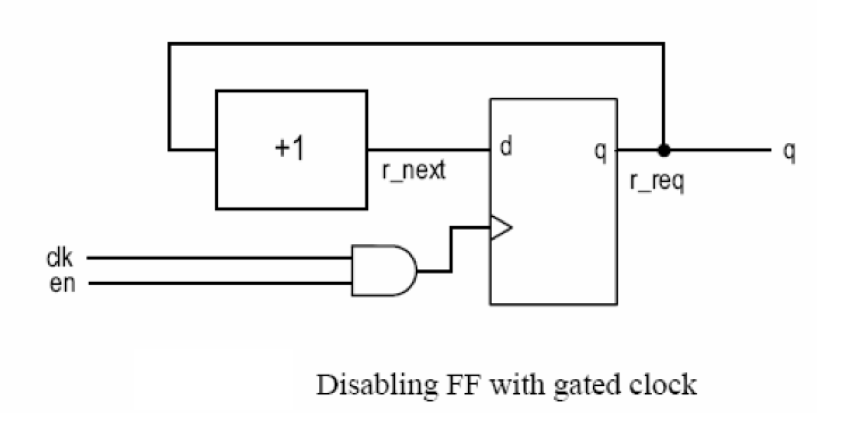
Misuse of Gated Clock
Problem
  Gated clock width can be narrow
  Gated clock may pass glitches of en
  Difficult to design clock distribution network

Slide 46
Dedicated Clock Tree Network – H Tree

Slide 47
Disuse of Derived Clock
Subsystems may run at different clock rate
Poor design: use a derived slow clock for slow subsystems
  Multiple clock distribution network
  How about timing analysis? (maximal clock rate)

Slide 48
Disuse of Derived Clock - Solution
Better use a synchronous one-clock enable pulse

Slide 49
Bad Design
E.g., second and minutes counter
  Input: 1 MHz clock
  Poor design

Slide 50
Better Design

Slide 51
Dual-edge triggered register/counter (1)
In FPGAs register/counter can change only
at either rising (default) or falling edge of the
clock.
Dual-edge triggered clock is not synthesizable
correctly, using either of the descriptions
provided below.

Slide 52
Dual-edge triggered register/counter (2)
PROCESS (clk)
BEGIN
IF (clk’EVENT AND clk=‘1’ ) THEN
counter <= counter + 1;
ELSIF (clk’EVENT AND clk=‘0’ ) THEN
counter <= counter + 1;
END IF;
END PROCESS;

Slide 53
Dual-edge triggered register/counter (3)
PROCESS (clk)
BEGIN
IF (clk’EVENT) THEN
counter <= counter + 1;
END IF;
END PROCESS;
PROCESS (clk)
BEGIN
counter <= counter + 1;
END PROCESS;

Slide 54
ROM

Slide 55
Instruction ROM example (1)
LIBRARY ieee;
USE ieee.std_logic_1164.all;
USE ieee.numeric_std.all;
ENTITY instruction_rom IS
GENERIC ( w : INTEGER := 16;
n : INTEGER := 8;
m : INTEGER := 3);
PORT (
Instr_addr : IN STD_LOGIC_VECTOR(m-1 DOWNTO 0);
Instr : out STD_LOGIC_VECTOR(w-1 DOWNTO 0)
);
END instruction_rom;

Slide 56
Instruction ROM example (2)
ARCHITECTURE ins_rom OF instruction_rom IS
SIGNAL temp: INTEGER RANGE 0 TO n-1;
TYPE vector_array IS ARRAY (0 to n-1) OF STD_LOGIC_VECTOR(w-1 DOWNTO 0);
CONSTANT memory : vector_array :=
( X"0000",
X"D459",
X"A870",
X"7853",
X"650D",
X"642F",
X"F742",
X"F548");
BEGIN
temp <= to_integer(unsigned(Instr_addr));
Instr <= memory(temp);
END instruction_rom;

Slide 57
References
Stephen Brown and Zvonko Vranesic. 2004. Fundamentals of Digital Logic with VHDL Design. McGraw-Hill, Inc., New York, NY, USA.
https://ece.gmu.edu/coursewebpages/ECE/ECE545/F18/viewgraphs/ECE545_lecture_7_poor_practices.pdf
https://ece.gmu.edu/coursewebpages/ECE/ECE545/F18/viewgraphs/ECE545_lecture_9_FSM_refresher.pdf
P. Chu, RTL Hardware Design using VHDL
  Chapter 9.1 Poor design practices and their remedies

Slide 58
Questions?

