Slide 1

EEL4712 Digital Design
(Carry Lookahead Adder)

Slide 2
VHDL Design Styles
VHDL Design
Styles
Testbenches
behavioral
(sequential)
dataflow
structural
Concurrent
statements
Components and
interconnects
Sequential statements
Registers
State machines
Instruction decoders
Subset most suitable for synthesis

Slide 3
Register Transfer Level (RTL) Design Description
Today’s Topic
…
Combinational
Logic
Combinational
Logic
Registers

Slide 4
MLU Example

Slide 5

MLU Block Diagram
MUX_0
A
0
1
A1
MUX_4_1
IN0
Y1
NEG_A
MUX_1
IN1
0
1
MUX_2
IN2
OUTPUT
Y
IN3
SEL0
SEL1
NEG_Y
B
0
1
B1
L1
L0
MUX_3
NEG_B

Slide 6
MLU: Entity Declaration
LIBRARY ieee;
USE ieee.std_logic_1164.all;
ENTITY mlu IS
PORT(
NEG_A : IN STD_LOGIC;
NEG_B : IN STD_LOGIC;
NEG_Y : IN STD_LOGIC;
A : IN STD_LOGIC;
B : IN STD_LOGIC;
L1 : IN STD_LOGIC;
L0 : IN STD_LOGIC;
Y : OUT STD_LOGIC
);
END mlu;

Slide 7
MLU: Architecture Declarative Section
ARCHITECTURE mlu_dataflow OF mlu IS
SIGNAL A1 : STD_LOGIC;
SIGNAL B1 : STD_LOGIC;
SIGNAL Y1 : STD_LOGIC;
SIGNAL MUX_0 : STD_LOGIC;
SIGNAL MUX_1 : STD_LOGIC;
SIGNAL MUX_2 : STD_LOGIC;
SIGNAL MUX_3 : STD_LOGIC;
SIGNAL L: STD_LOGIC_VECTOR(1 DOWNTO 0);

Slide 8
MLU - Architecture Body
BEGIN
A1<= NOT A WHEN (NEG_A='1') ELSE
A;
B1<= NOT B WHEN (NEG_B='1') ELSE
B;
Y <= NOT Y1 WHEN (NEG_Y='1') ELSE
Y1;
MUX_0 <= A1 AND B1;
MUX_1 <= A1 OR B1;
MUX_2 <= A1 XOR B1;
MUX_3 <= A1 XNOR B1;
L <= L1 & L0;
with (L) select
Y1 <= MUX_0 WHEN "00",
MUX_1 WHEN "01",
MUX_2 WHEN "10",
MUX_3 WHEN OTHERS;
END mlu_dataflow;

Slide 9
Buffers

Slide 10
Tri-state Buffer
e
x
f
e
= 0
(a) A tri-state buffer
x
f
e
x
f
e
= 1
x
f
0
0
Z
0
1
Z
1
0
0
(b) Equivalent circuit
1
1
1
(c) Truth table

Slide 11
Four types of Tri-state Buffers

Slide 12
Tri-state Buffer – example (1)
LIBRARY ieee;
USE ieee.std_logic_1164.all;
ENTITY tri_state IS
PORT ( ena: IN STD_LOGIC;
input: IN STD_LOGIC;
output: OUT STD_LOGIC
);
END tri_state;

Slide 13
Tri-state Buffer – example (2)
ARCHITECTURE dataflow OF tri_state IS
BEGIN
output <= input WHEN (ena = ‘1’) ELSE ‘Z’;
END dataflow;

Slide 14
Wire and Buses

Slide 15
Merging wires and buses
a
4
10
b
d
5
c
SIGNAL a: STD_LOGIC_VECTOR(3 DOWNTO 0);
SIGNAL b: STD_LOGIC_VECTOR(4 DOWNTO 0);
SIGNAL c: STD_LOGIC;
SIGNAL d: STD_LOGIC_VECTOR(9 DOWNTO 0);
d <= a & b & c;

Slide 16
Splitting buses
a
4
10
d
b
5
c
SIGNAL a: STD_LOGIC_VECTOR(3 DOWNTO 0);
SIGNAL b: STD_LOGIC_VECTOR(4 DOWNTO 0);
SIGNAL c: STD_LOGIC;
SIGNAL d: STD_LOGIC_VECTOR(9 DOWNTO 0);
a <= d(9 downto 6);
b <= d(5 downto 1);
c <= d(0);

Slide 17
Carry Lookahead Adders

Slide 18
Introduction
There are many ways to implement a digital function, but each approach may have different tradeoffs
As a digital designer, you need to consider these tradeoffs when meeting design requirements
As an example, we’ll look into different adder architectures and their tradeoffs
  Read Section 5.4 for more details

Slide 19
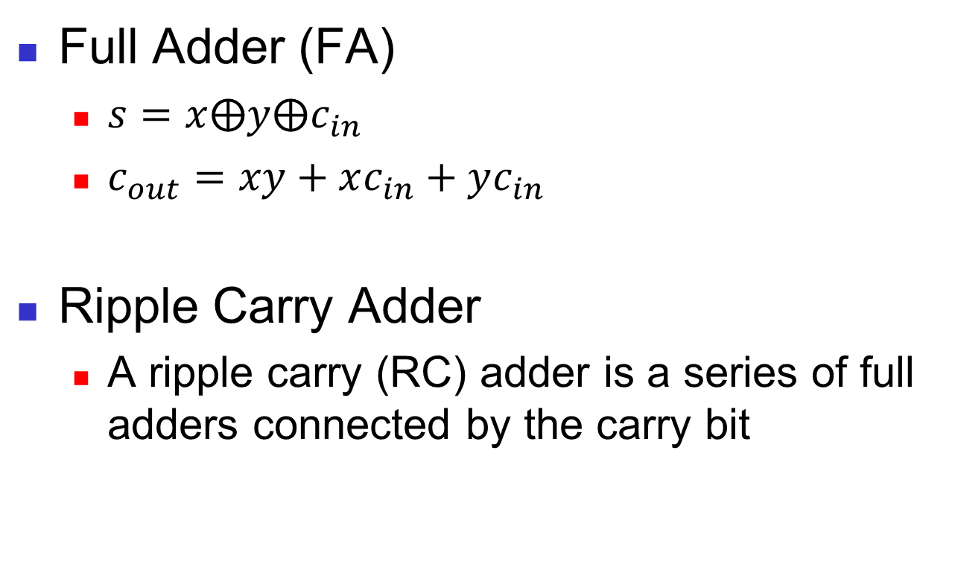
Ripple Carry Adder
Full Adder (FA)
  $s=x⨁y⨁c_{in}$
  $c_{out}=xy+xc_{in}+yc_{in}$
Ripple Carry Adder
  A ripple carry (RC) adder is a series of full adders connected by the carry bit

Slide 20
Advantage: Area Impact
The ripple carry adder’s area grows linearly with bit width
Each additional bit adds another full adder and its associated gates
+5 gates
+5 gates
+5 gates
+5 gates

Slide 21
Disadvantage: Delay Impact
The ripple carry adder’s delay also grows linearly with bit width
Each full adder must wait for the previous full adder to produce outputs
  Lower performance with bit width!
C₄@9Δ
C₃@7Δ
C₂@5Δ
C₁@3Δ

Slide 22
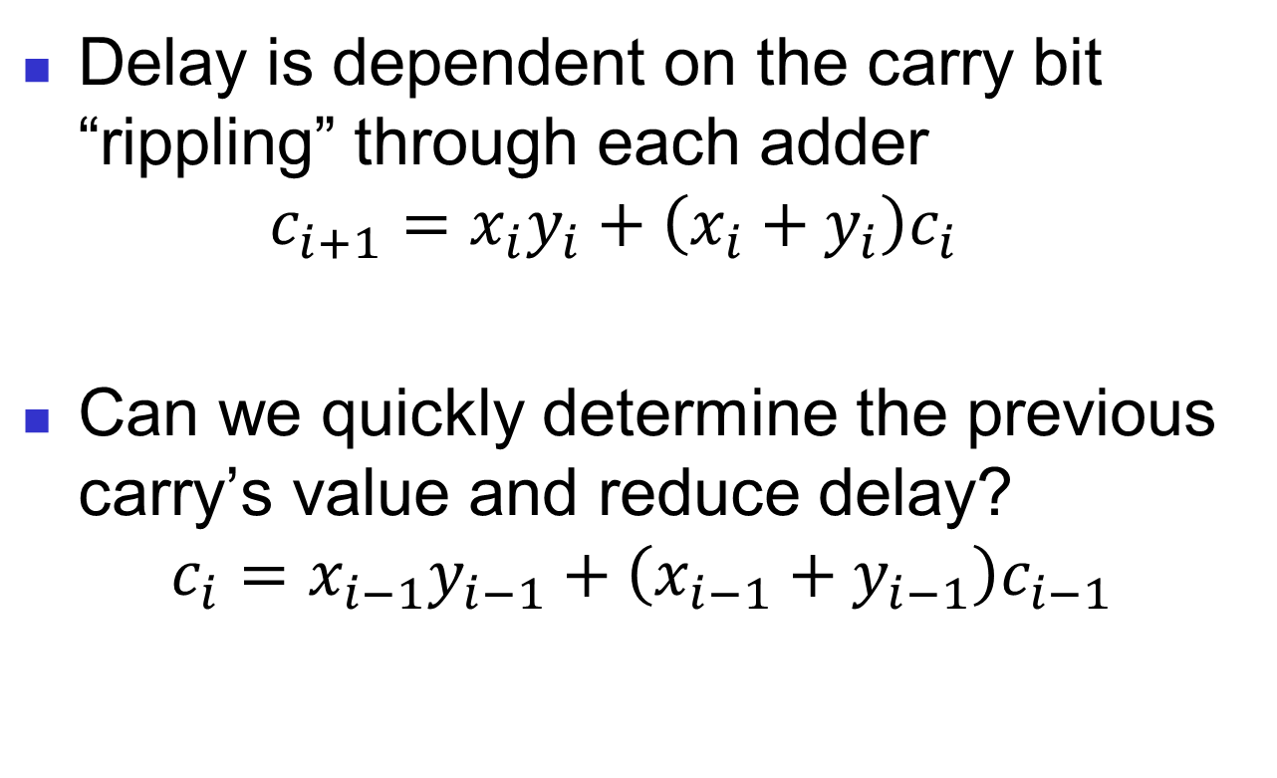
Delay Problem
Delay is dependent on the carry bit “rippling” through each adder
$c_{i+1}=x_{i}y_{i}+\left(x_{i}+y_{i}\right)c_{i}$
Can we quickly determine the previous carry’s value and reduce delay?
$$c_{i}=x_{i−1}y_{i−1}+\left(x_{i−1}+y_{i−1}\right)c_{i−1}$$

Slide 23
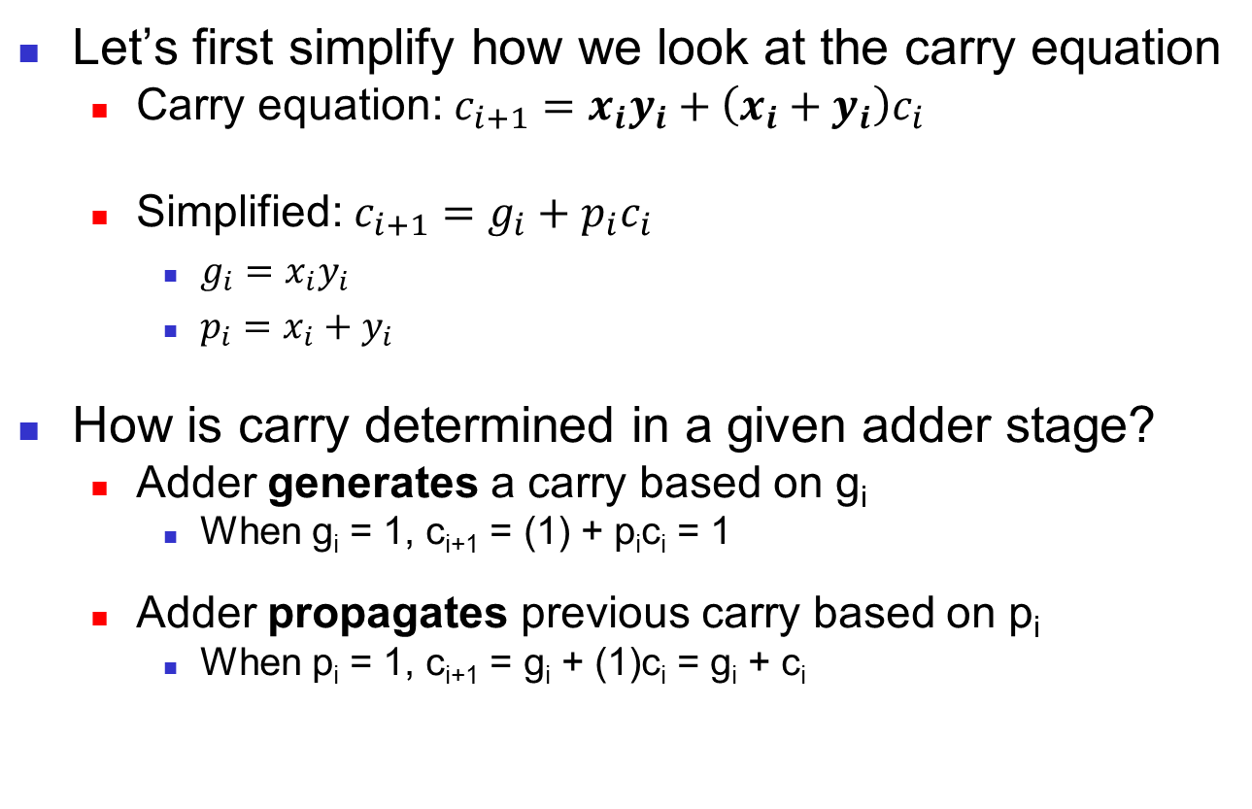
Simplifying Carry Equation
Let’s first simplify how we look at the carry equation
  Carry equation: $c_{i+1}=x_{i}y_{i}+\left(x_{i}+y_{i}\right)c_{i}$
  Simplified: $c_{i+1}=g_{i}+p_{i}c_{i}$
    $g_{i}=x_{i}y_{i}$
    $p_{i}=x_{i}+y_{i}$
How is carry determined in a given adder stage?
  Adder generates a carry based on g_{i}
    When g_{i} = 1, c_{i+1} = (1) + p_{i}c_{i} = 1
  Adder propagates previous carry based on p_{i}
    When p_{i} = 1, c_{i+1} = g_{i} + (1)c_{i} = g_{i} + c_{i}

Slide 24
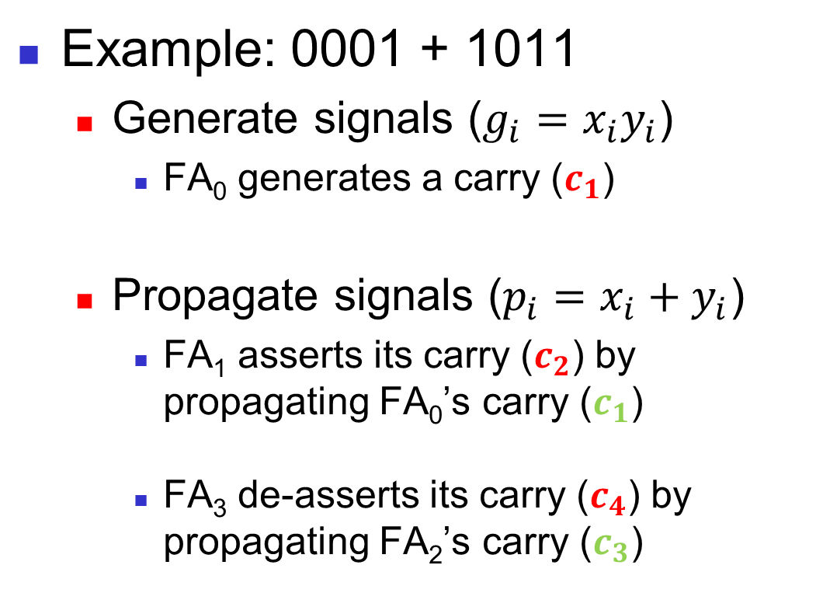
Generate/Propagate Example
Example: 0001 + 1011
  Generate signals ($g_{i}=x_{i}y_{i}$)
    FA₀ generates a carry ($c_{1}$)
  Propagate signals ($p_{i}=x_{i}+y_{i}$)
    FA₁ asserts its carry ($c_{2}$) by propagating FA₀’s carry ($c_{1}$)
    FA₃ de-asserts its carry ($c_{4}$) by propagating FA₂’s carry ($c_{3}$)
1
0001
+1011
0
11
0001
+1011
00
0011
0001
+1011
1100

Slide 25
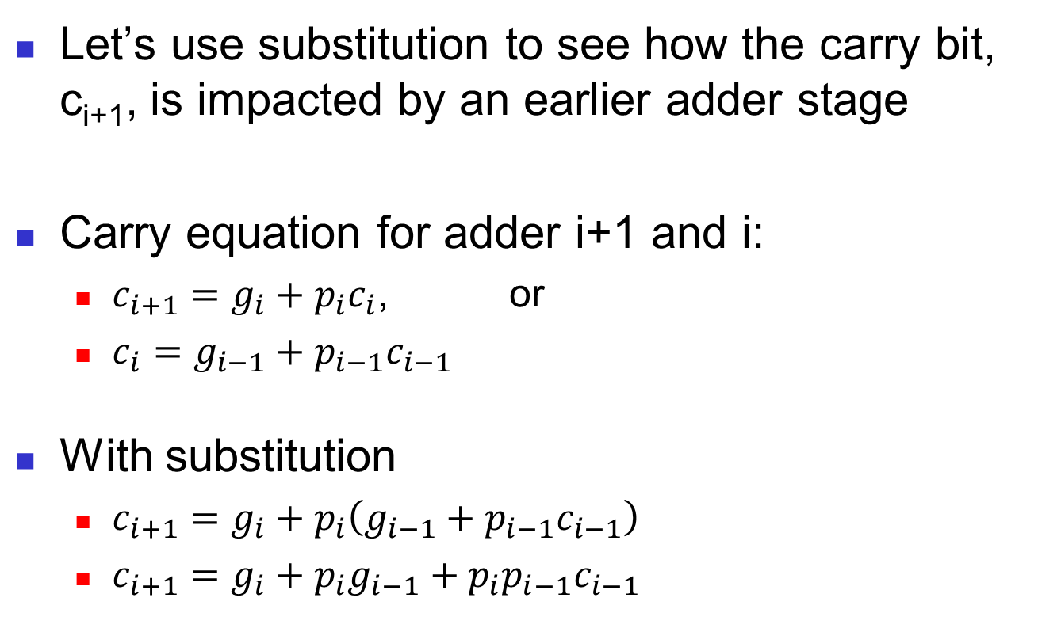
Carry Substitution
Let’s use substitution to see how the carry bit, c_{i+1}, is impacted by an earlier adder stage
Carry equation for adder i+1 and i:
  $c_{i+1}=g_{i}+p_{i}c_{i}$, or
  $c_{i}=g_{i−1}+p_{i−1}c_{i−1}$
With substitution
  $c_{i+1}=g_{i}+p_{i}\left(g_{i−1}+p_{i−1}c_{i−1}\right)$
  $c_{i+1}=g_{i}+{p_{i}g}_{i−1}+p_{i}p_{i−1}c_{i−1}$
c_{i}

Slide 26
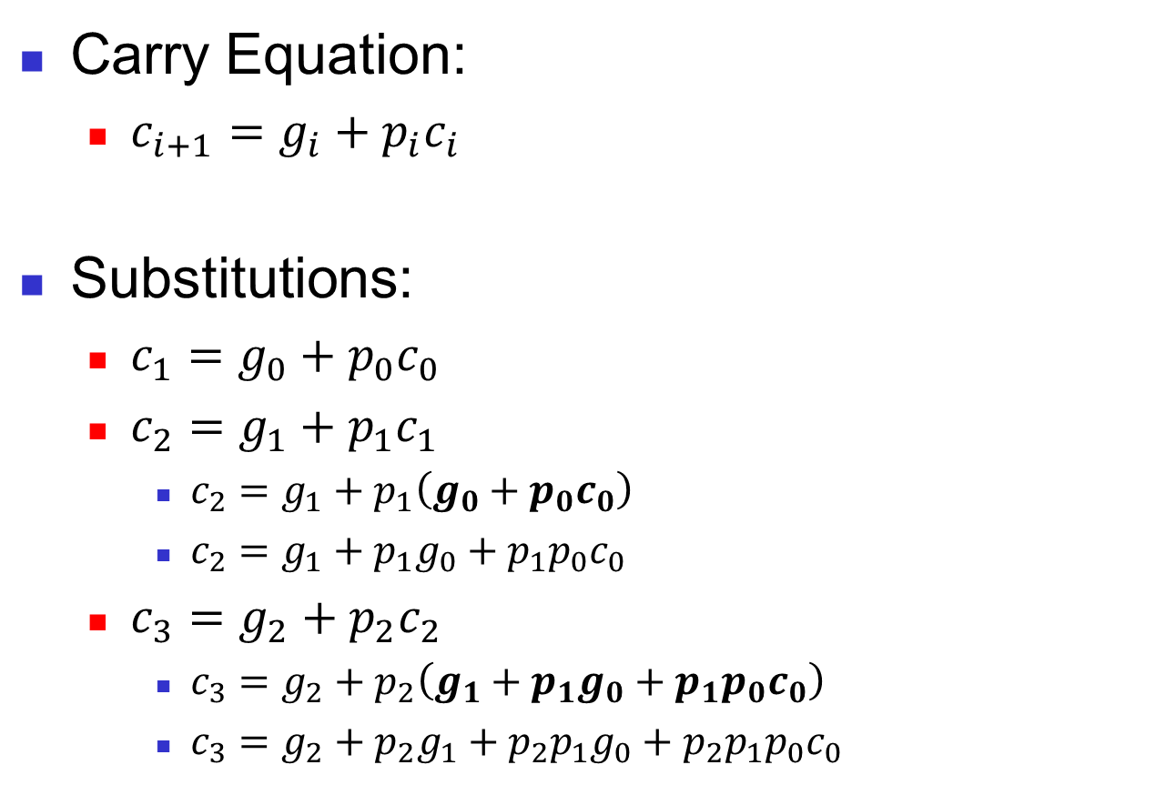
Carry Pattern
Carry Equation:
  $c_{i+1}=g_{i}+p_{i}c_{i}$
Substitutions:
  $c_{1}=g_{0}+p_{0}c_{0}$
  $c_{2}=g_{1}+p_{1}c_{1}$
    $c_{2}=g_{1}+p_{1}\left(g_{0}+p_{0}c_{0}\right)$
    $c_{2}=g_{1}+p_{1}g_{0}+p_{1}p_{0}c_{0}$
  $c_{3}=g_{2}+p_{2}c_{2}$
    $c_{3}=g_{2}+p_{2}\left(g_{1}+p_{1}g_{0}+p_{1}p_{0}c_{0}\right)$
    $c_{3}=g_{2}+p_{2}g_{1}+p_{2}p_{1}g_{0}+p_{2}p_{1}p_{0}c_{0}$
c₁
c₂

Slide 27
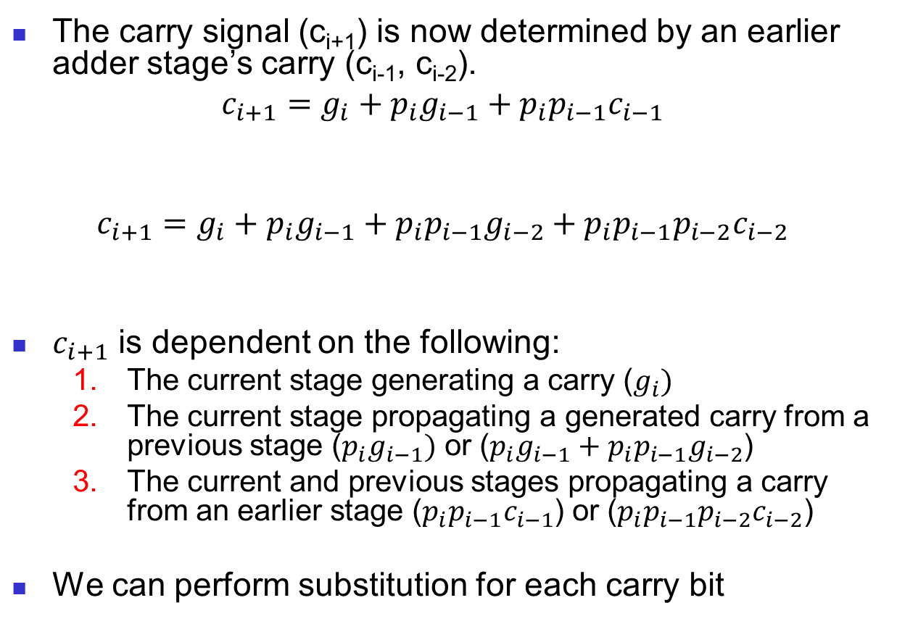
Removing Dependencies
The carry signal (c_{i+1}) is now determined by an earlier adder stage’s carry (c_{i-1}, c_{i-2}).
$$c_{i+1}=g_{i}+{p_{i}g}_{i−1}+p_{i}p_{i−1}c_{i−1}$$
$$c_{i+1}=g_{i}+{p_{i}g}_{i−1}+p_{i}p_{i−1}g_{i−2}+p_{i}p_{i−1}p_{i−2}c_{i−2}$$
$c_{i+1}$ is dependent on the following:
  The current stage generating a carry ($g_{i})$
  The current stage propagating a generated carry from a previous stage ($p_{i}g_{i−1})$ or (${p_{i}g}_{i−1}+p_{i}p_{i−1}g_{i−2}$)
  The current and previous stages propagating a carry from an earlier stage ($p_{i}p_{i−1}c_{i−1}$) or ($p_{i}p_{i−1}p_{i−2}c_{i−2}$)
We can perform substitution for each carry bit
Case 1
Case 2
Case 3
Case 1
Case 2
Case 3

Slide 28
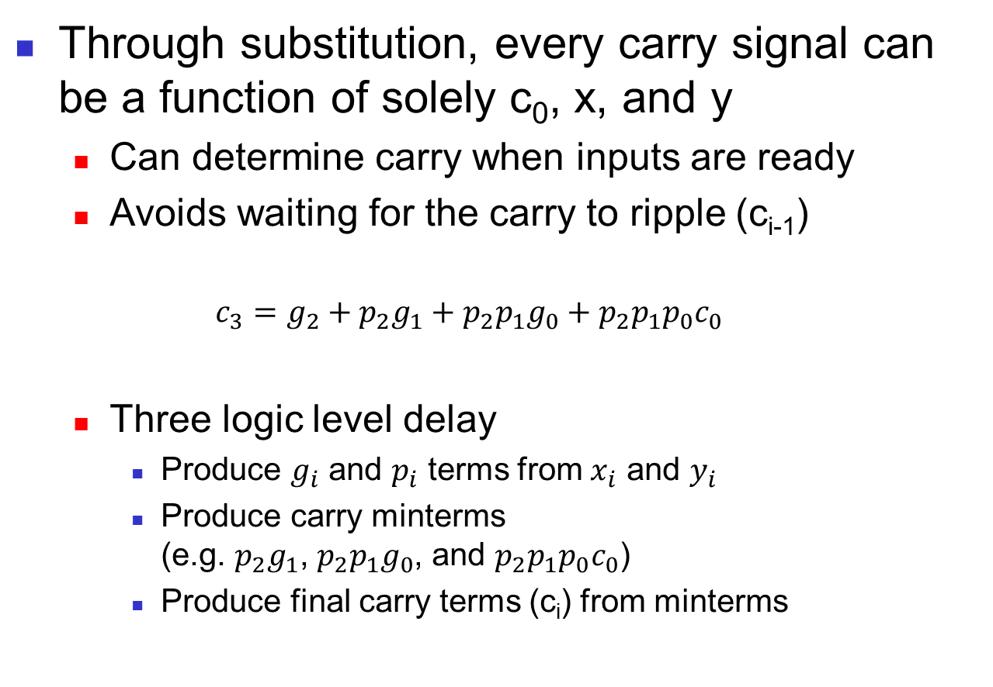
New Carry Dependence
Through substitution, every carry signal can be a function of solely c₀, x, and y
  Can determine carry when inputs are ready
  Avoids waiting for the carry to ripple (c_{i-1})
  $$c_{3}=g_{2}+p_{2}g_{1}+p_{2}p_{1}g_{0}+p_{2}p_{1}p_{0}c_{0}$$
  Three logic level delay
    Produce $g_{i}$ and $p_{i}$ terms from $x_{i}$ and $y_{i}$
    Produce carry minterms
    (e.g. $p_{2}g_{1}$, $p_{2}p_{1}g_{0}$, and $p_{2}p_{1}p_{0}c_{0}$)
    Produce final carry terms (c_{i}) from minterms

Slide 29
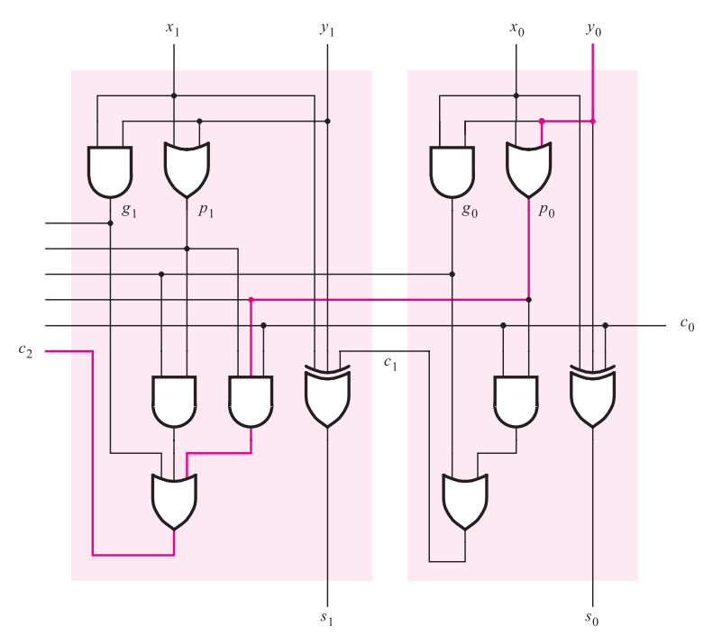
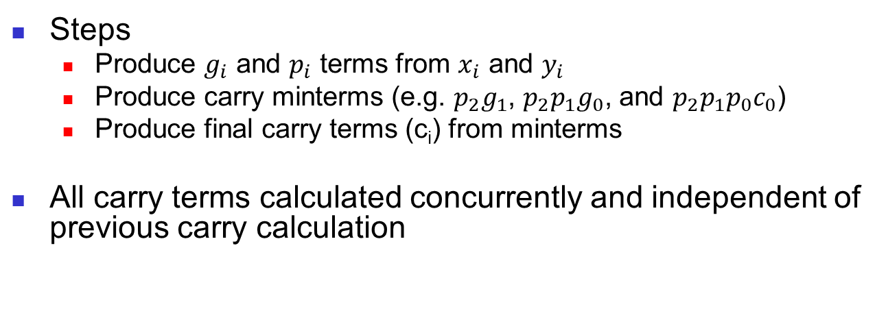
Carry Lookahead Adder (CLA)
Steps
  Produce $g_{i}$ and $p_{i}$ terms from $x_{i}$ and $y_{i}$
  Produce carry minterms (e.g. $p_{2}g_{1}$, $p_{2}p_{1}g_{0}$, and $p_{2}p_{1}p_{0}c_{0}$)
  Produce final carry terms (c_{i}) from minterms
All carry terms calculated concurrently and independent of previous carry calculation
propagate/generate terms
carry minterms
carry term
[1]

Slide 30
Constant Delay
The propagation delay is now constant, even as the adder width increases!
  Each of the CLA adder stages calculate its outputs concurrently
  By contrast, RC ripples carry through each stage and has a variable delay based on width

Slide 31
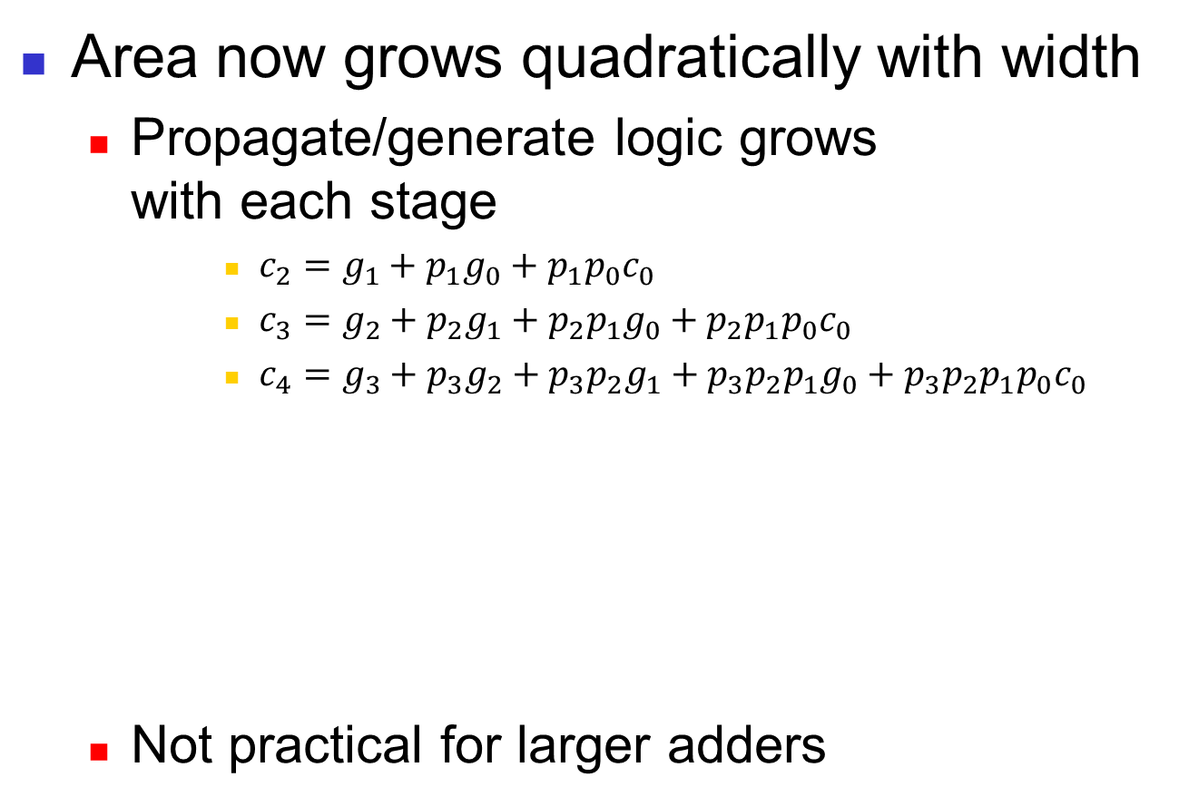
Area Cost
Area now grows quadratically with width
  Propagate/generate logic grows
  with each stage
      $c_{2}=g_{1}+p_{1}g_{0}+p_{1}p_{0}c_{0}$
      $c_{3}=g_{2}+p_{2}g_{1}+p_{2}p_{1}g_{0}+p_{2}p_{1}p_{0}c_{0}$
      $c_{4}=g_{3}+p_{3}g_{2}+p_{3}p_{2}g_{1}+p_{3}p_{2}p_{1}g_{0}+p_{3}p_{2}p_{1}p_{0}c_{0}$
  Not practical for larger adders

Slide 32
Other Tradeoffs?
We know of two adders with different advantages as width increases
  The ripple carry’s area grows linearly, but suffers from linear growth in delay
  The carry lookahead’s delay is constant, but suffers from quadratic growth in area
Use hybrid architecture to limit both area and delay growth?

Slide 33
Hybrid Approach
Make a ripple carry architecture out of multi-bit CLAs adders, or CLA blocks
  E.g. 4-bit CLA adders connected in a ripple carry fashion

Slide 34
Area Impact
The hybrid adder’s area grows linearly
  Additional bits add another CLA adder and its associated gates
  Slower area growth than pure CLA, but larger area than pure RC

Slide 35
Delay Impact
The hybrid adder’s delay grows linearly
  Each CLA adder must wait for the previous CLA adder to produce outputs
    But no longer on a bit-by-bit basis!
  Lower delay growth than pure RC

Slide 36
Alternative Hierarchical Approach
In the hybrid approach, we use the RC architecture on multi-bit CLA adders
Alternatively, we can also use the CLA architecture with multi-bit CLA adders
  Use CLA architecture to gain constant delay as width increases
  Must determine propagate and generate logic on a CLA block-basis

Slide 37
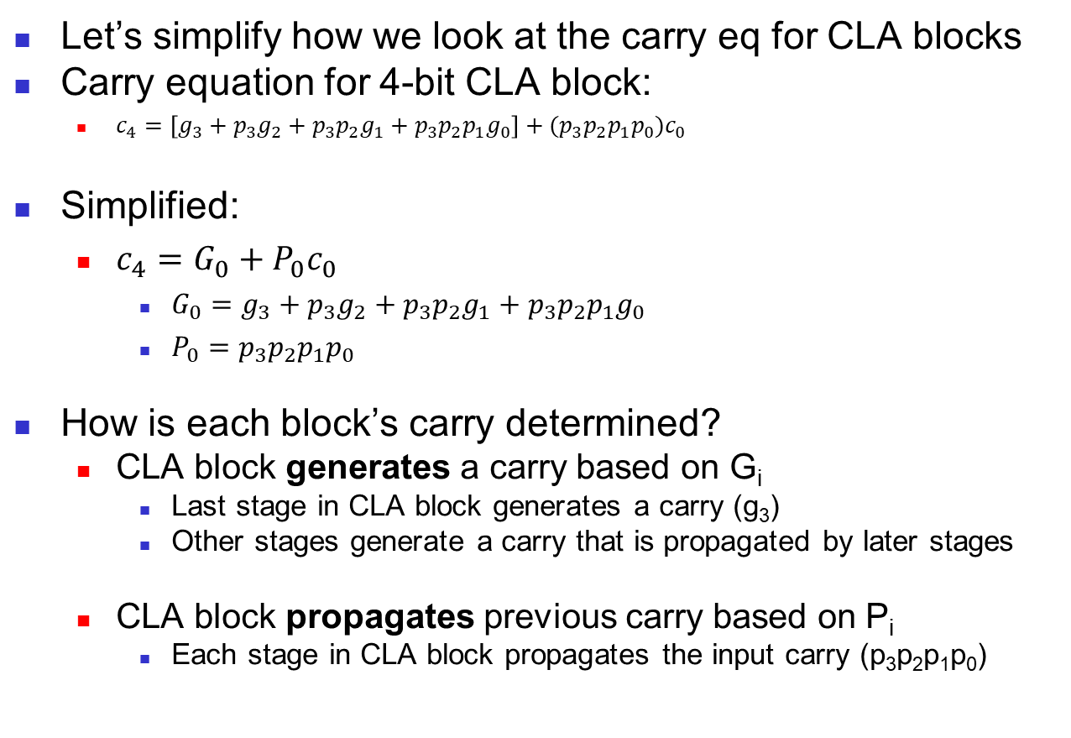
Another Look at Carry Equations
Let’s simplify how we look at the carry eq for CLA blocks
Carry equation for 4-bit CLA block:
  $c_{4}=\left[g_{3}+p_{3}g_{2}+p_{3}p_{2}g_{1}+p_{3}p_{2}p_{1}g_{0}\right]+(p_{3}p_{2}p_{1}p_{0})c_{0}$
Simplified:
  $c_{4}=G_{0}+P_{0}c_{0}$
    $G_{0}=g_{3}+p_{3}g_{2}+p_{3}p_{2}g_{1}+p_{3}p_{2}p_{1}g_{0}$
    $P_{0}=p_{3}p_{2}p_{1}p_{0}$
How is each block’s carry determined?
  CLA block generates a carry based on G_{i}
    Last stage in CLA block generates a carry (g₃)
    Other stages generate a carry that is propagated by later stages
  CLA block propagates previous carry based on P_{i}
    Each stage in CLA block propagates the input carry (p₃p₂p₁p₀)

Slide 38
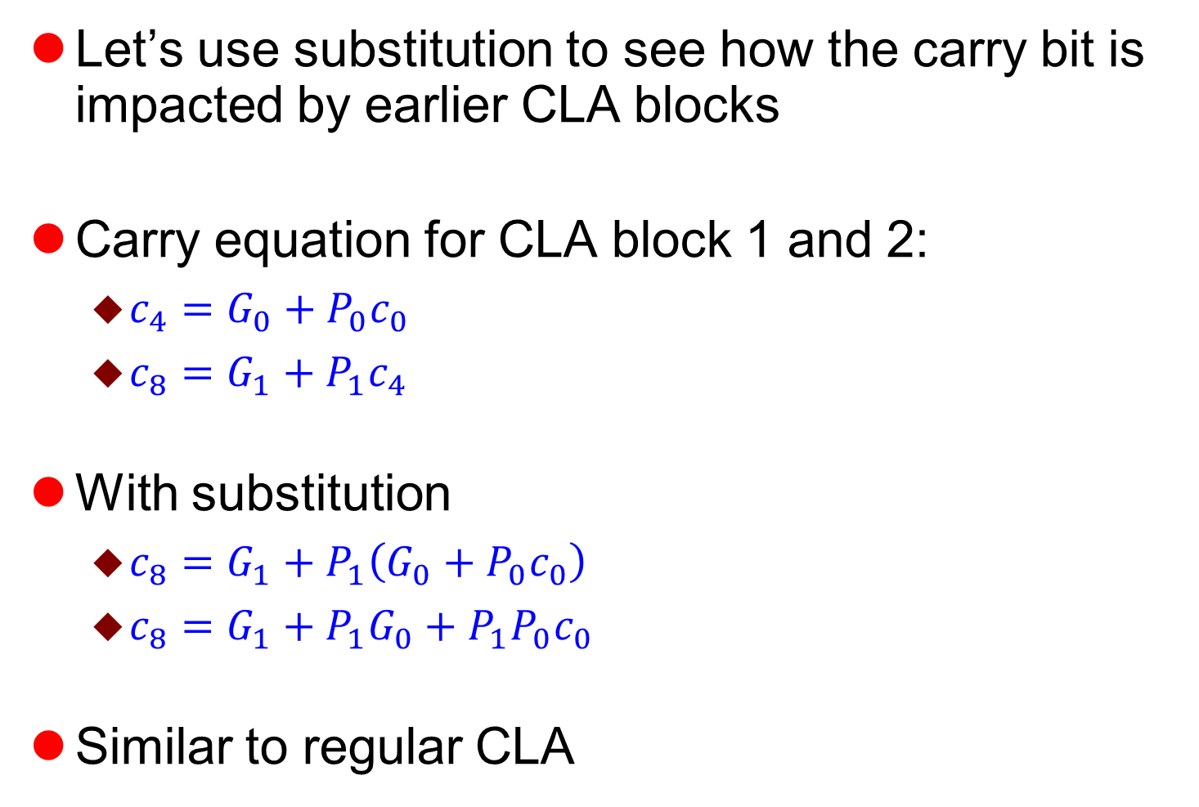
Hierarchical Carry Substitution
Let’s use substitution to see how the carry bit is impacted by earlier CLA blocks
Carry equation for CLA block 1 and 2:
  $c_{4}=G_{0}+P_{0}c_{0}$
  $c_{8}=G_{1}+P_{1}c_{4}$
With substitution
  $c_{8}=G_{1}+P_{1}\left(G_{0}+P_{0}c_{0}\right)$
  $c_{8}=G_{1}+P_{1}G_{0}+P_{1}P_{0}c_{0}$
Similar to regular CLA

Slide 39
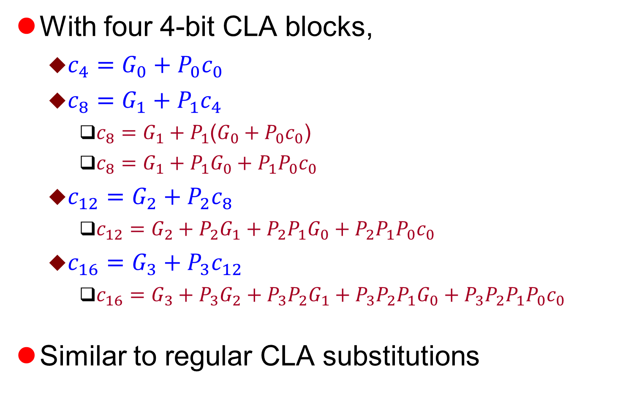
Hierarchical Substitutions
With four 4-bit CLA blocks,
  $c_{4}=G_{0}+P_{0}c_{0}$
  $c_{8}=G_{1}+P_{1}c_{4}$
    $c_{8}=G_{1}+P_{1}$($G_{0}+P_{0}c_{0}$)
    $c_{8}=G_{1}+P_{1}G_{0}+P_{1}P_{0}c_{0}$
  $c_{12}=G_{2}+P_{2}c_{8}$
    $c_{12}=G_{2}+P_{2}G_{1}+P_{2}P_{1}G_{0}+P_{2}P_{1}P_{0}c_{0}$
  $c_{16}=G_{3}+P_{3}c_{12}$
    $c_{16}=G_{3}+P_{3}G_{2}+P_{3}P_{2}G_{1}+P_{3}P_{2}P_{1}G_{0}+P_{3}P_{2}P_{1}P_{0}c_{0}$
Similar to regular CLA substitutions

Slide 40
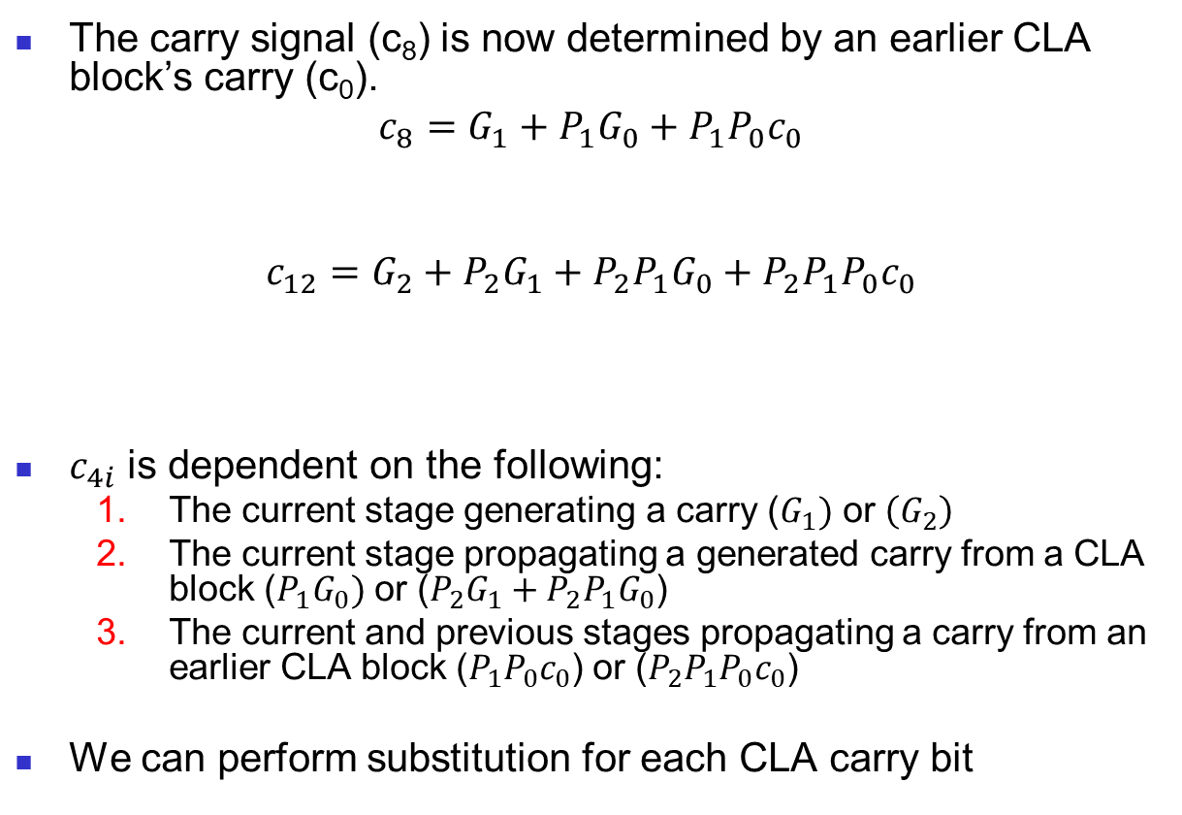
Removing Dependencies
The carry signal (c₈) is now determined by an earlier CLA block’s carry (c₀).
$$c_{8}=G_{1}+P_{1}G_{0}+P_{1}P_{0}c_{0}$$
$$c_{12}=G_{2}+P_{2}G_{1}+P_{2}P_{1}G_{0}+P_{2}P_{1}P_{0}c_{0}$$
$c_{4i}$ is dependent on the following:
  The current stage generating a carry ($G_{1})$ or $\left(G_{2}\right)$
  The current stage propagating a generated carry from a CLA block ($P_{1}G_{0})$ or ($P_{2}G_{1}+P_{2}P_{1}G_{0}$)
  The current and previous stages propagating a carry from an earlier CLA block ($P_{1}P_{0}c_{0}$) or ($P_{2}P_{1}P_{0}c_{0}$)
We can perform substitution for each CLA carry bit
Case 1
Case 2
Case 3
Case 1
Case 2
Case 3

Slide 41
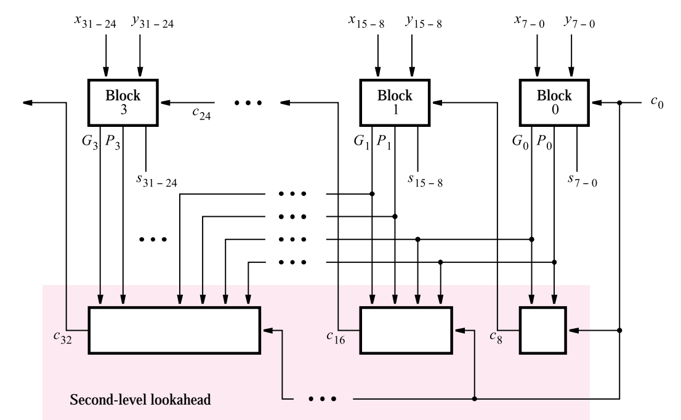
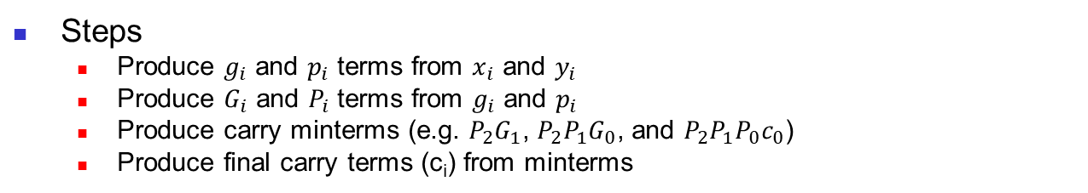
Hierarchical CLA
Steps
  Produce $g_{i}$ and $p_{i}$ terms from $x_{i}$ and $y_{i}$
  Produce $G_{i}$ and $P_{i}$ terms from $g_{i}$ and $p_{i}$
  Produce carry minterms (e.g. $P_{2}G_{1}$, $P_{2}P_{1}G_{0}$, and $P_{2}P_{1}P_{0}c_{0}$)
  Produce final carry terms (c_{i}) from minterms
propagate/generate
terms (steps 1 & 2)
carry terms
(steps 3 & 4)
Figure 2. A hierarchical carry-lookahead adder [1]

Slide 42
Hierarchical CLA
Compared to pure CLA
  Smaller quadratic area growth
    Block propagate/generate logic extracts common propagate/generate terms
    Avoids duplicating gates for common propagate/generate terms in each carry equation
  Larger constant delay due to block propagate/generate logic.
Figure 2. A hierarchical carry-lookahead adder [1]

Slide 43
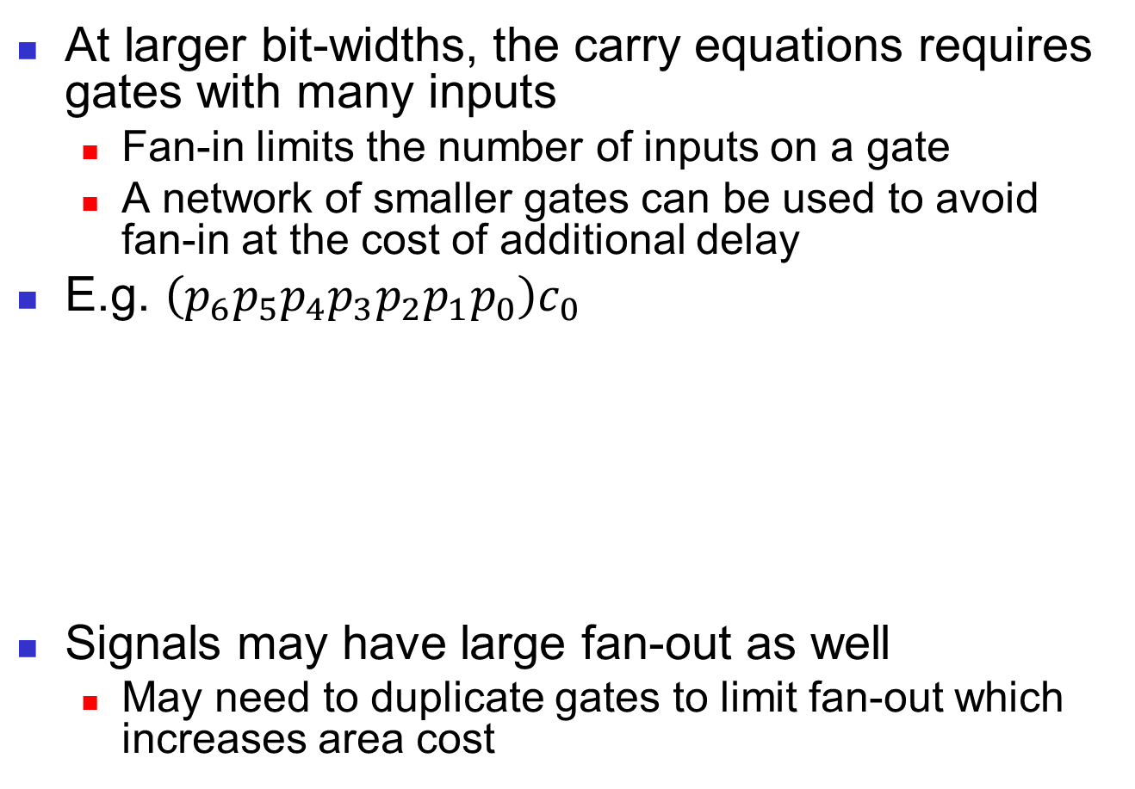
Practical Limitations
At larger bit-widths, the carry equations requires gates with many inputs
  Fan-in limits the number of inputs on a gate
  A network of smaller gates can be used to avoid fan-in at the cost of additional delay
E.g. $\left(p_{6}p_{5}p_{4}p_{3}p_{2}p_{1}p_{0}\right)c_{0}$
Signals may have large fan-out as well
  May need to duplicate gates to limit fan-out which increases area cost
Ideally
Practically

Slide 44
Multi-level Hierarchical Approaches
Similar to the past two architectures, we can add additional hierarchical levels for different area/delay tradeoffs
  May help with fan-in/fan-out as
  width increases
  Ideal number of levels dependent on width

Slide 45
Conclusions
Two adder architectures with different area/delay tradeoffs
  Ripple carry adder
  Carry lookahead adder
Two hierarchical architectures with different area/delay tradeoffs
  Hybrid architecture
  Hierarchical CLA
Questions?

Slide 46
References
Stephen Brown and Zvonko Vranesic. 2004. Fundamentals of Digital Logic with VHDL Design with CD-ROM (2 ed.). McGraw-Hill, Inc., New York, NY, USA.
http://www.gstitt.ece.ufl.edu/courses/spring19/eel4712/index.html
https://ece.gmu.edu/coursewebpages/ECE/ECE545/F10/viewgraphs/ECE545_lecture5_dataflow.pdf

Slide 47
Questions?

