Slide 1
EEL4712 Digital Design
(Lab 1)
https://ece.gmu.edu/coursewebpages/ECE/ECE545/F18/
Thanks to Prof. Gaj for providing his course materials.

Slide 2
Variables
Used for
Local storage in processes, functions, …
Their scope is within the procedure that they have been defined
Declararion
variable list_of_variable_names : type_name [ := initial value ];
variable temp_var : std_logic_vector (WIDTH downto 0);
Usage
Variable_name := value;
temp_var := ("0"&input1) + ("0"&input2);

Slide 3
Signals
Must be declared outside a process
Declaration form:
signal list_of_signal_names : type_name [ := initial value ];
signal temp_sig : std_logic_vector(WIDTH downto 0);
Declared in an architecture body and can be used anywhere within that architecture
Usage
temp_var <= ("0"&input1) + ("0"&input2);

Slide 4
Signals vs Variables
Variables
The right-hand side expression is evaluated immediately and the variable is instantaneously updated (no delay)
Signals
The right-hand side expression is evaluated and the signal is scheduled to change after delay
The signal value will be updated at the end of process (if the signal assignment is in the process)

Slide 5
Example: Signals vs Variables
architecture BHV1 of add is
begin
process (input1, input2)
varailable temp_var : std_logic_vector(WIDTH downto 0);
begin
temp_var := ("0"&input1) + ("0"&input2);
output <= temp_var(WIDTH-1 downto 0);
carry <= temp_var(WIDTH);
end process;
end BHV1;
1) temp_sig/temp_var = 0, input1 = 0, and input2 = 15
2) Input1 changes to 10
3) The sum of input1 and input2 (25)
4) Input1 changes to 20, causing the process to execute
6) Temp_sig is assigned the new value of 35, but the following lines will see the previous value of 25, causing the output to be set to 25.
architecture BHV2 of add is
signal temp_sig : std_logic_vector(WIDTH downto 0);
begin
process (input1, input2)
begin
temp_sig <= ("0"&input1) + ("0"&input2);
output <= temp_sig(WIDTH-1 downto 0);
carry <= temp_sig(WIDTH);
end process;
end BHV2;

Slide 6
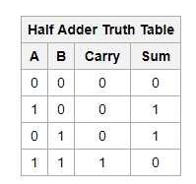
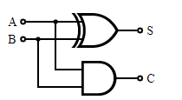
Half Adder
Sum
Carry
entity half_adder_vhdl is port (Sum, Carry: out Std_Logic; A, B: in Std_Logic); end half_adder_vhdl;
architecture BHV of half_adder_vhdl is Sum <= A xor B; Carry <= A and B; end BHV;

Slide 7
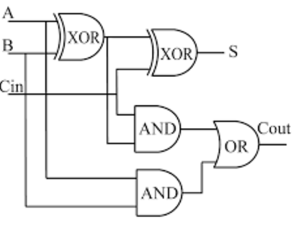
Full Adder
A | B | Cin | S | Cout
0 | 0 | 0 | 0 | 0
0 | 0 | 1 | 1 | 0
0 | 1 | 0 | 1 | 0
0 | 1 | 1 | 0 | 1
1 | 0 | 0 | 1 | 0
1 | 0 | 1 | 0 | 1
1 | 1 | 0 | 0 | 1
1 | 1 | 1 | 1 | 1

Slide 8
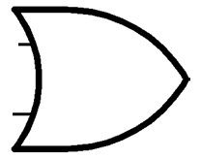
Full Adder
A
Sum
A
S
Half Adder
Sum
A
B
Half Adder
B
Carry
B
Cout
Cin
Carry

Slide 9
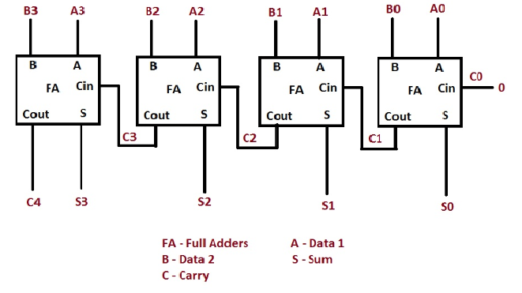
4-Bit Ripple Carry Adder
Notes:
Ref: https://allthingsvlsi.wordpress.com/2013/04/30/4-bit-ripple-carry-adder/

Slide 10
Questions?

