Slide 1
EEL4712 Digital Design
(Combinational Logic Building Blocks)
Ref: S. Dandamudi, “Fundamentals of Computer Organization and Design”
Brown and Vranesic, “Fundamentals of Digital logics with VHDL Design”
https://ece.gmu.edu/coursewebpages/ECE/ECE545/F10/viewgraphs/ECE545_lecture1_digital_logic_review.pdf

Slide 2
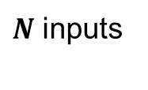
2x1 Multiplexer
Truth Table
w1
0
If (sel = ‘0’) then
output <= w1;
else
output <= w2;
end if;
sel | f
0 | w1
1 | w2
f
w2
1
sel
$$w_{1}$$
N binary inputs
$\log_{2}^{N}$ Selection inputs
One binary output
One of the inputs are placed onto the output port
.
0
.
$N$ inputs
f
1
$$w_{N}$$
$\log_{2}^{N}$ Selection inputs
Notes:
We can create larger multiplexers with 2 to 1 multiplexers

Slide 3
2x1 Multiplexer: VHDL Implementation
-- VHDL behavioral description of two-input multiplexer
entity mux_2x1 is
port (f : out std_logic;
w1, w2: in std_logic;
sel: in std_logic);
end mux_2x1;
Architecture Behavioral of mux_2x1is
Begin
process (w1, w2, sel) begin
if sel = '1' then
f <= w2;
else f <= w1;
end_if;
end process;
end Behavioral;

Slide 4
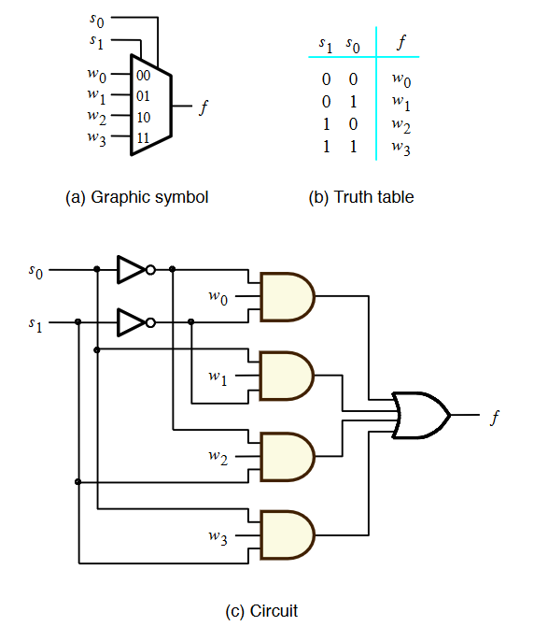
4-to-1 Multiplexer
-- VHDL behavioral description of four-input mux
entity mux_4x1 is
port (f: out Std_Logic;
w0, w1, w2, w3: in std_logic;
Sel : in std_logic_vector (1 downto 0)
);
end mux_4x1;
Architecture Behavioral of mux_4x1 is
begin
process (w0, w1, w2, w3, sel) begin
case select is
when 0 => f = w0;
when 1 => f= w1;
when 2 => f= w2;
when 3 => f= w3;
when others => f= ‘X';
endcase;
end process;
end Behavioral;

Slide 5
Mux4-to-1
w0
0
w1
1
0
f
sel0
1
w2
0
sel1
w3
1
sel0

Slide 6
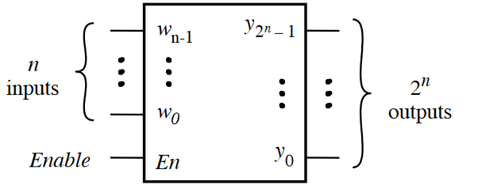
Decoders
It takes N binary inputs
It generates $2^{N}$ outputs
Function: Decode the encoded information
If enable is 1, output is asserted high, the rest of outputs are asserted low
If enable is 0, all output ports are asserted low
Decoders are often used for memory (RAM/ROM) addressing

Slide 7
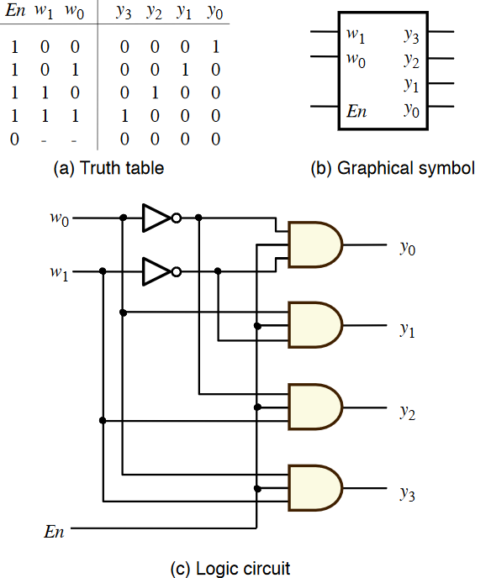
2-to-4 Decoder – VHDL Implementation
entity decoder_2x4 is
port (
Y: out std_logic_vector (3 downto 0); w1, w2, en: in Std_Logic
);
end decoder_2x4;
Architecture Behavioral of decoder_2x4 is
begin
process (w1, w0, en)
begin
Y(0) <= (not w1) and (not w2) and (en);
Y(1) <= (not w1) and w2 and (en);
Y(2) <= w1 and (not w2) and (en);
Y(3) <= w1 and w0 and (not en);
end process;
end Behavioral;

Slide 8
4-to-1 Multiplexer using a Decoder?
Create a 4-to-1 multiplexer using a 2-to-4 decoder
You may use some additional logic

Slide 9
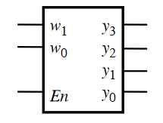
Solution
w0
w1
w2
w3

Slide 10
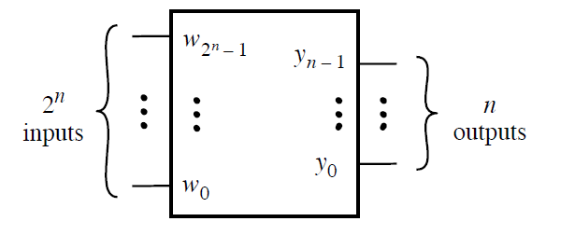
Encoder
It takes $2^{N}$ inputs
It generates N binary outputs
Function: it encodes information into an n-bit code
Encoders only work when exactly one binary input is equal to 1

Slide 11
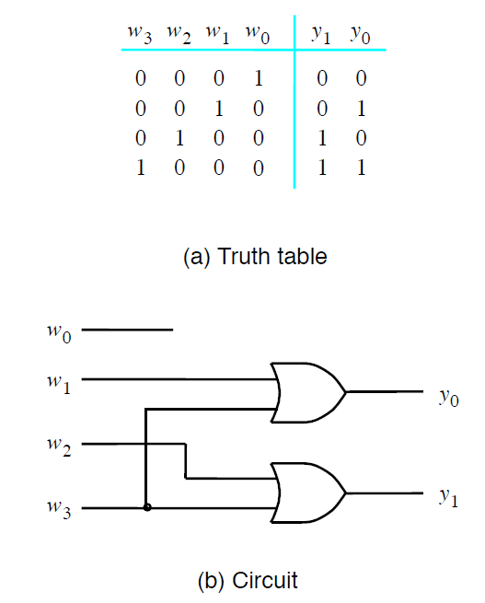
4-to-2 Encoder
entity encoder is
port (w: in STD_LOGIC_VECTOR(3 downto 0) ;
y : out STD_LOGIC_VECTOR(1 downto 0) ) ;
end encoder ;
Architecture behavioral of encoder is
begin
process(w)
begin
if (w = “0001”) then
y <= “00”;
elsif (w = “0010”) then
y <= “01”;
elsif (w = “0100”) then
y <= ”10”;
elsif (w = “1000”) then
y <= “11”;
end if ;
end process ;
end behavioral ;

Slide 12
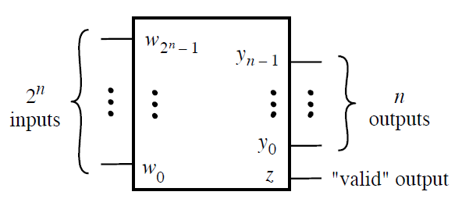
Priority Encoder
It takes $2^{N}$ inputs
It generates N binary outputs
1 binary valid output
Function: it encodes information into an n-bit code
Priority encoders allow for multiple inputs be '1’
MSB = highest priority, LSB = lowest priority

Slide 13
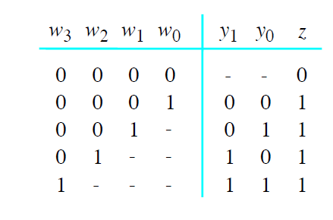
4-to-2 Priority Encoder
entity priority_encoder is
port (w: in STD_LOGIC_VECTOR(3 downto 0) ;
y : out STD_LOGIC_VECTOR(1 downto 0) ) ;
end priority_encoder;
Architecture behavioral of priority_encoder is
Signal valid: std_logic := ‘0’;
begin
process(w)
begin
if (w(3) = ‘1’) then
y <= “11” ; valid <= ‘1’;
elsif (w(2) = ‘1’) then
y <= “10”; valid <= ‘1’;
elsif (w(1) = ‘1’) then
y <= “01”; valid <= ‘1’;
elsif (w(0) = ‘1’) then
y <= “00”; valid <= ‘1’;
end if ;
end process ;
end behavioral ;

Slide 14
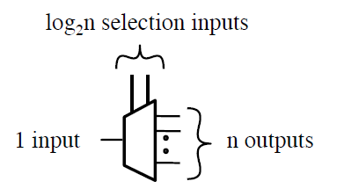
Demultiplexer
1 binary inputs
N binary outputs
$\log_{2}^{N}$ binary selection inputs
Functions: it places input onto one of N outputs, with the remaining outputs zeros
Try to construct them using decoders!!!!!!!

Slide 15
Reminders
Please read chapter 6
Lab 0 is on the website
http://farimah.ece.ufl.edu/teaching/eel4712/assignments-labs/

Slide 16
Questions?

