Slide 1

EEL4712 Digital Design
(VHDL Tutorial)

Slide 2


Abstraction Levels
Register Transfer Level (RTL):
  High-level VHDL designs usually described at this level
Ref: VHDL: Modular Design and Synthesis of Cores and Systems, Z. Navabi, 2007

Slide 3
RTL Design Flow
RTL Design
Flow
Design Entry
Testbench in VHDL
Design Validation
Compilation
and Synthesis
Gate-level
Post-synthesis
Simulation
Timing
Analysis
Hardware
Generation
Ref: VHDL: Modular Design and Synthesis of Cores and Systems, Z. Navabi, 2007

Slide 4
RTL Design Flow
Design Entry
  Describing the design in VHDL in a top-down hierarchical fashion
Testbench Generation
  Generate test data that can activate various functionality of the design
Design Validation
  The process to check the design for any design flaws
  Can be done
    Simulation
    Assertion-based verification
    Formal Methods
Compilation and Synthesis
  The process of automatic hardware generation from a RTL design
    Gate-level designs
Ref: VHDL: Modular Design and Synthesis of Cores and Systems, Z. Navabi, 2007

Slide 5
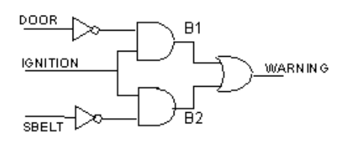
Design Description
Behavioral Description
  Describe a system in terms of how it behaves
  Specifies the relations between input and output signals
Structural Description
  Describe a system as a collection of gates that are interconnected to perform a function
Example
  Consider a circuit that warns car passengers when the door is open or the seatbelt is not used whenever the engine is one
If (ignition is on)
Begin
warning <= (Door is open) or (seatbelt is off)
end
Behavioral Representation
Structural Representation
Ref: https://www.seas.upenn.edu/~ese171/vhdl/vhdl_primer.html
Notes:
Ref: https://www.seas.upenn.edu/~ese171/vhdl/vhdl_primer.html

Slide 6
Basic Structure of a VHDL File
VHDL Entity
ENTITY entity1 IS
PORT (
i1, i2 : in std_logic;
w1 : out std_logic
);
END ENTITY entity1;
ARCHITECTURE simple1 OF entity1 IS
SIGNAL s1 : std_logic;
BEGIN
statement1;
statement2;
statement3;
END ARCHITECTURE simple1;
Interface
(Entity Declaration)
Ports
Body
(Architecture)
Sequential
Combinational
Processes
Subprograms
Ref: VHDL: Modular Design and Synthesis of Cores and Systems, Z. Navabi, 2007

Slide 7
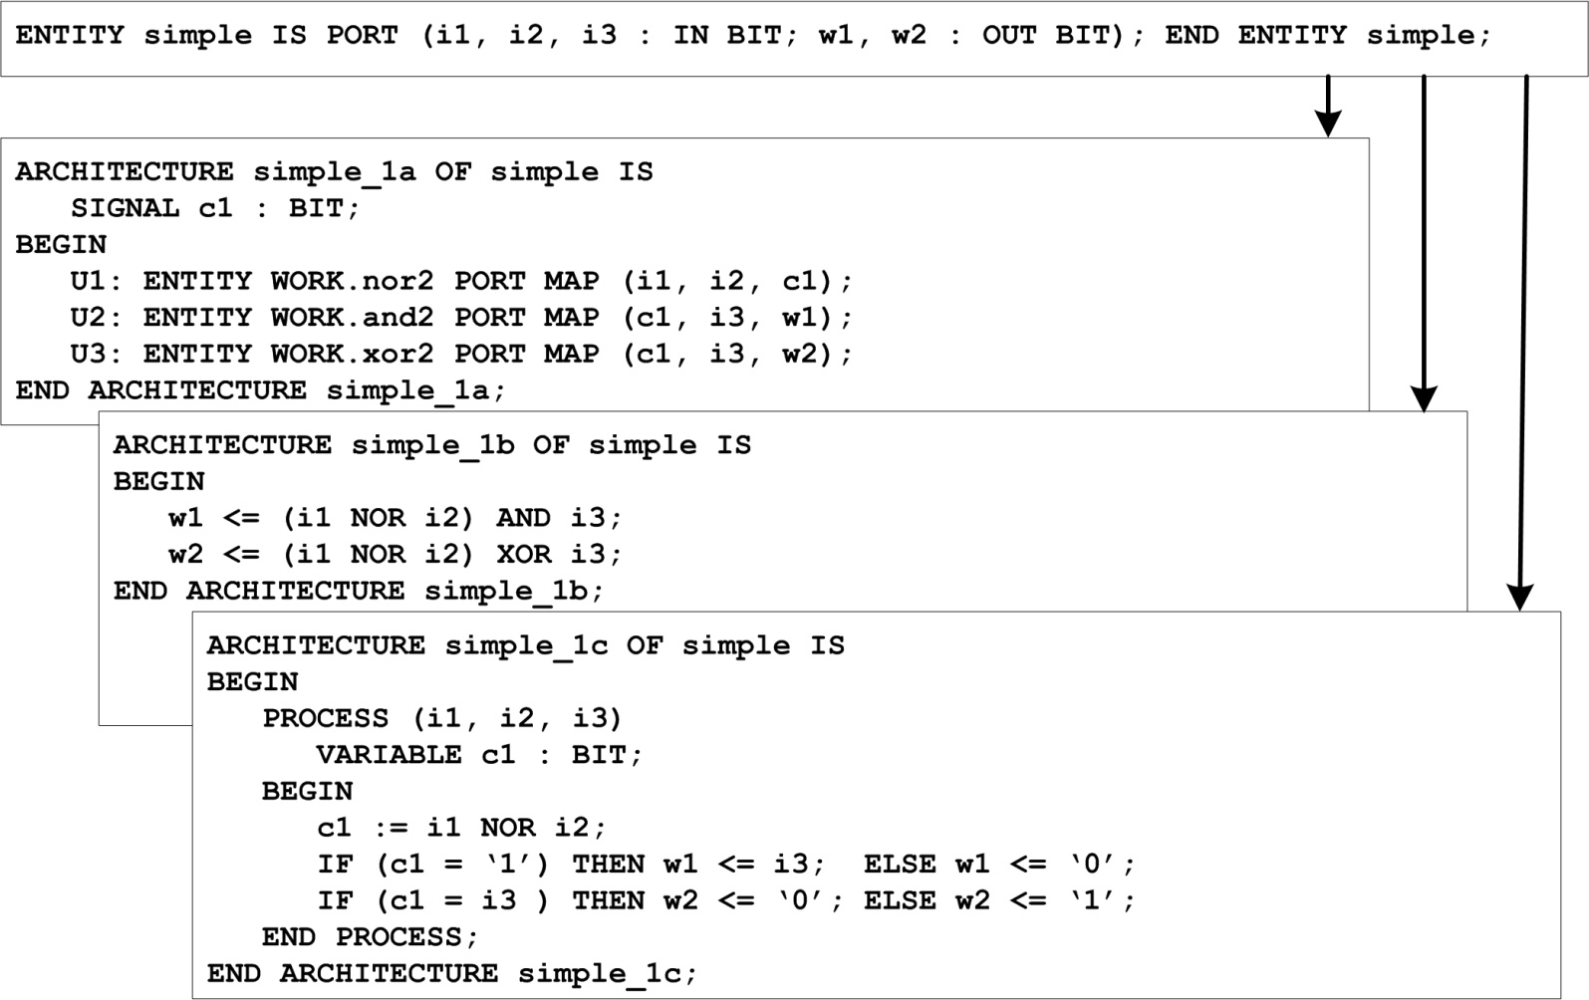
Entity-Architecture Outline
Ref: VHDL: Modular Design and Synthesis of Cores and Systems, Z. Navabi, 2007

Slide 8
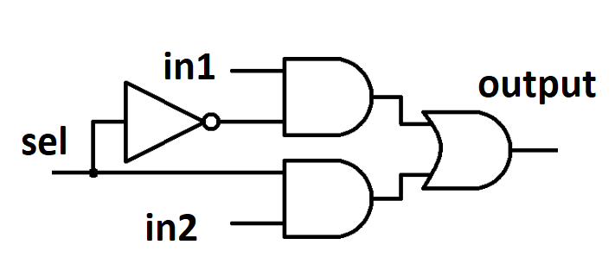
Example: 2x1 Multiplexer
Truth Table
sel | in1 | in2 | out
0 | 0 | 0 | 0
0 | 0 | 1 | 0
0 | 1 | 0 | 1
0 | 1 | 1 | 1
1 | 0 | 0 | 0
1 | 0 | 1 | 1
1 | 1 | 0 | 0
1 | 1 | 1 | 1
in1
0
output
in2
1
sel
If (sel = ‘0’) then
output <= in1;
else
output <= in2;
end if;
Notes:
We can create larger multiplexers with 2 to 1 multiplexers

Slide 9
Entity Ports
entity NAME_OF_ENTITY is [ generic generic_declarations);]
port (signal_names: mode type;
signal_names: mode type;
:
signal_names: mode type);
end [NAME_OF_ENTITY] ;
The NAME_OF_ENTITY is a user-selected identifier
signal_names specify external interface signals.
mode: indicates the signal direction:
  in: indicates that the signal is an input
  out: indicates that the signal is an output of the entity whose value can only be read by other entities that use it.
  Buffer: indicates that the signal is an output of the entity whose value can be read inside the entity’s architecture
  Inout: the signal can be an input or an output.
type: a built-in or user-defined signal type
  Bit: can have the value 0 and 1
  bit_vector: is a vector of bit values (e.g. bit_vector (0 to 7)
  std_logic, std_ulogic, std_logic_vector, std_ulogic_vector
    can have 9 values to indicate the value and strength of a signal.
  Std_ulogic and std_logic are preferred over the bit or bit_vector types.
  Boolean: can have the value TRUE and FALSE
  Integer: can have a range of integer values
  Real: can have a range of real values
  Character: any printing character
  Time: to indicate time
Representing | Value
Uninitialized | 'U'
Forcing Unknown | 'X'
Forcing 0 | '0'
Forcing 1 | '1'
High Impedance | 'Z'
Weak Unknown | 'W'
Weak 0 | 'L'
Weak 1 | 'H'
Don’t care | '-'
Ref: https://www.seas.upenn.edu/~ese171/vhdl/vhdl_primer.html
Notes:
generic: generic declarations are optional and determine the local constants used for timing and sizing (e.g. bus widths) the entity. A generic can have a default value. The syntax for a generic follows,
generic (
constant_name: type [:=value] ;
constant_name: type [:=value] ;
:
constant_name: type [:=value] );

Slide 10
Entity Ports: Examples
2x1 Multiplexer
Buzzer circuit
entity mux_2x1 is
port(
  in1 : in std_logic;
  in2 : in std_logic;
  sel : in std_logic;
  output : out std_logic);
end mux_2x1;
in1
0
output
in2
1
sel
entity BUZZER is
port (
DOOR, IGNITION, SBELT: in std_logic;
WARNING: out std_logic);
end BUZZER;
Ref: https://www.seas.upenn.edu/~ese171/vhdl/vhdl_primer.html

Slide 11
Architecture Body
The architecture body specifies how the circuit operates and how it is implemented.
architecture architecture_name of NAME_OF_ENTITY is
-- Declarations
-- components declarations
-- signal declarations
-- constant declarations
-- function declarations
-- procedure declarations
-- type declarations
:
begin
-- Statements
:
end architecture_name;
Ref: https://www.seas.upenn.edu/~ese171/vhdl/vhdl_primer.html

Slide 12
Architecture Body: Examples
2x1 Multiplexer
Buzzer
architecture procedural of multiplexer is begin
process (in1, in2, sel) begin
if (sel = '0') then
output <= in1;
else
output <= in2;
end if;
end process;
end architecture procedural;
architecture buzzer_arch of BUZZER is
begin
WARNING <= (not DOOR and IGNITION) or (not SBELT and IGNITION);
end buzzer_arch;

Slide 13
VHDL Operators
 | XNOR | XOR | NOR | NAND | OR | AND | NOT | Boolean Operators
 |  | >= | > | <= | < | /= | = | Comparison Operators
** | / | * | REM | MOD | ABS | - | + | Arithmetic Operators
 |  |  |  |  |  |  | & | Concat. Operators
Order of Processing
  **, ABS, NOT
  *, /, MOD, REM
  +, -
  =, /=, <, <=, >, >=
  AND, OR, NAND, NOR, XOR, XNOR
Processing
Ref: VHDL: Modular Design and Synthesis of Cores and Systems, Z. Navabi, 2007

Slide 14
Concurrent Assignment Statements
Simple Signal Assignment
  Signal_name <= Expression
Selected Signal Assignment
  Set the value of the signal to one of the several options based on selection operation (only one can be true)
Conditional Signal Assignment
  Set a signal to one of the several options (multiple conditions can be true)
Generate Statements
  Provides a way to repeating a logical expression or a component instantiation
with sel select
output <= in1 when ‘0’,
in2 when others;
output <= in1 when sel=‘0’ else
in2 when sel=‘1’ else
‘X’;

Slide 15
Sequential Assignment Statements
Sequential statements execute sequentially within a process
  A process executes every time one of the signals in the sensitivity list changes
  Within a process, each statement is sequential
  Process statements without sensitivity list are like infinite loops
    You can use them in testbenches
process_label :process(sensitivity_list)
-- declarative part
begin
-- sequential statement
end process process_label;

Slide 16
Sequential Assignment Statements
If Statement
Case Statement
process(in1, in2, sel)
begin
if (sel = '0') then
output <= in1;
else
output <= in2;
end if;
end process;
process(in1, in2, sel) case sel is
when '0' =>
output <= in1;
when others => output <= in2;
end case;

Slide 17
Component Instantiation
Label: identifies unique instance of component
Component Type: selects the desired declared component
Port Map: connects Component to signals in the architecture
Testbench
Set input values, check output values
SystemToTest
Architecture Body
label
Component
U_WITH_SELECT : mux_2x1(WITH_SELECT)
port map ( in1 => in1, in2 => in2, sel => sel, output => output_with_select);
What You Instantiate
What You Defined in the New Entity
Ref: VHDL: Modular Design and Synthesis of Cores and Systems, Z. Navabi, 2007

Slide 18
Questions?

